Slide 2
Building real-time HTAP solutions with Azure Cosmos DB & Azure Synapse Analytics
Azure Synapse Link
Ramnandan Krishnamurthy
Product & Engineering, Azure Cosmos DB

Slide 3


Azure Cosmos DB
Fast NoSQL database with open APIs for any scale
Azure Cosmos DB is optimized for operational workloads with single-digit millisecond read and write latency
99.999% high availability, guaranteed throughput and consistency
Turnkey global data replication across all Azure regions
Real-time
Applications & Services
Azure
Cosmos DB
Notes:
Over the years, customers have chosen Azure Cosmos DB as the fully managed NoSQL database for modern application development. Azure Cosmos DB provides single-digit millisecond response times, automatic and instant scalability and guaranteed speed at any scale. Business continuity is assured with SLA-backed 99.999% availability and enterprise-grade security. App development is faster and more productive thanks to turnkey multi-master global distribution, open source APIs and SDKs for popular languages.
What are the requirements of modern applications:
Apps & services generate growing volumes of operational data
Users expect these apps & services to be milli-second response times and always-on
Businesses have to serve users who are globally distributed
Hence businesses have chosen Azure Cosmos DB as their operational database of choice courtesy ..

Slide 4
But what if I want to run analytics in near real-time on my operational data at scale?
Notes:
While app development is only 1 half of the story, we’ve seen from working with our customers that they almost always want to generate insights out of this rich data that apps generate. Think rich customer transaction data, or IOT sensor data from oil wells. Across industry verticals, customers are adopting a data-driven culture. At the core of this culture is the need to deliver analytics over operational data in near real-time at scale - to unlock new opportunities and optimize business processes. In order to do this, traditionally, there exists 2 options:

Slide 5



Running OLTP and OLAP workloads on the same database
If you have large amounts of data, analytical queries will take a long time to run and will be resource intensive.
HUGE performance impact on the OLTP workloads.
Real-time
Applications & Services
Azure
Cosmos DB
Reporting & Dashboards
Notes:
Data volume =>OLTP performance impact

Slide 6


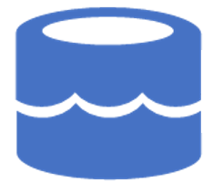
Separating OLTP & OLAP
Ingest data periodically from Azure Cosmos DB to Data Lake
Manage data formats and storage layer to optimize for analytics
Apache Spark for Synapse
Transform
Enrich
Extract (Pipelines)
Serve
User
Applications
Data Lake
Synapse SQL
Power BI
Azure Cosmos DB
Orchestrate
Notes:
To ensure that there is no performance impact on your applications or OLTP workloads, today data engineers
Create pipelines for data movement from Cosmos DB to ADLS.
Operationalize the pipelines
Monitor and manage the pipelines.
Then the same needs to be done where the data lands –
Ensure the data is in the right format , for example., columnar formats for analytics workloads
Create and manage the storage account where the data is moved
Only after these can you start to use the flexibility of your analytic workloads for ex. with Spark to transform or enrich and serve with SQL. But your analytical workloads are not running against the latest state of operational data due periodic ingest of data.

Slide 7
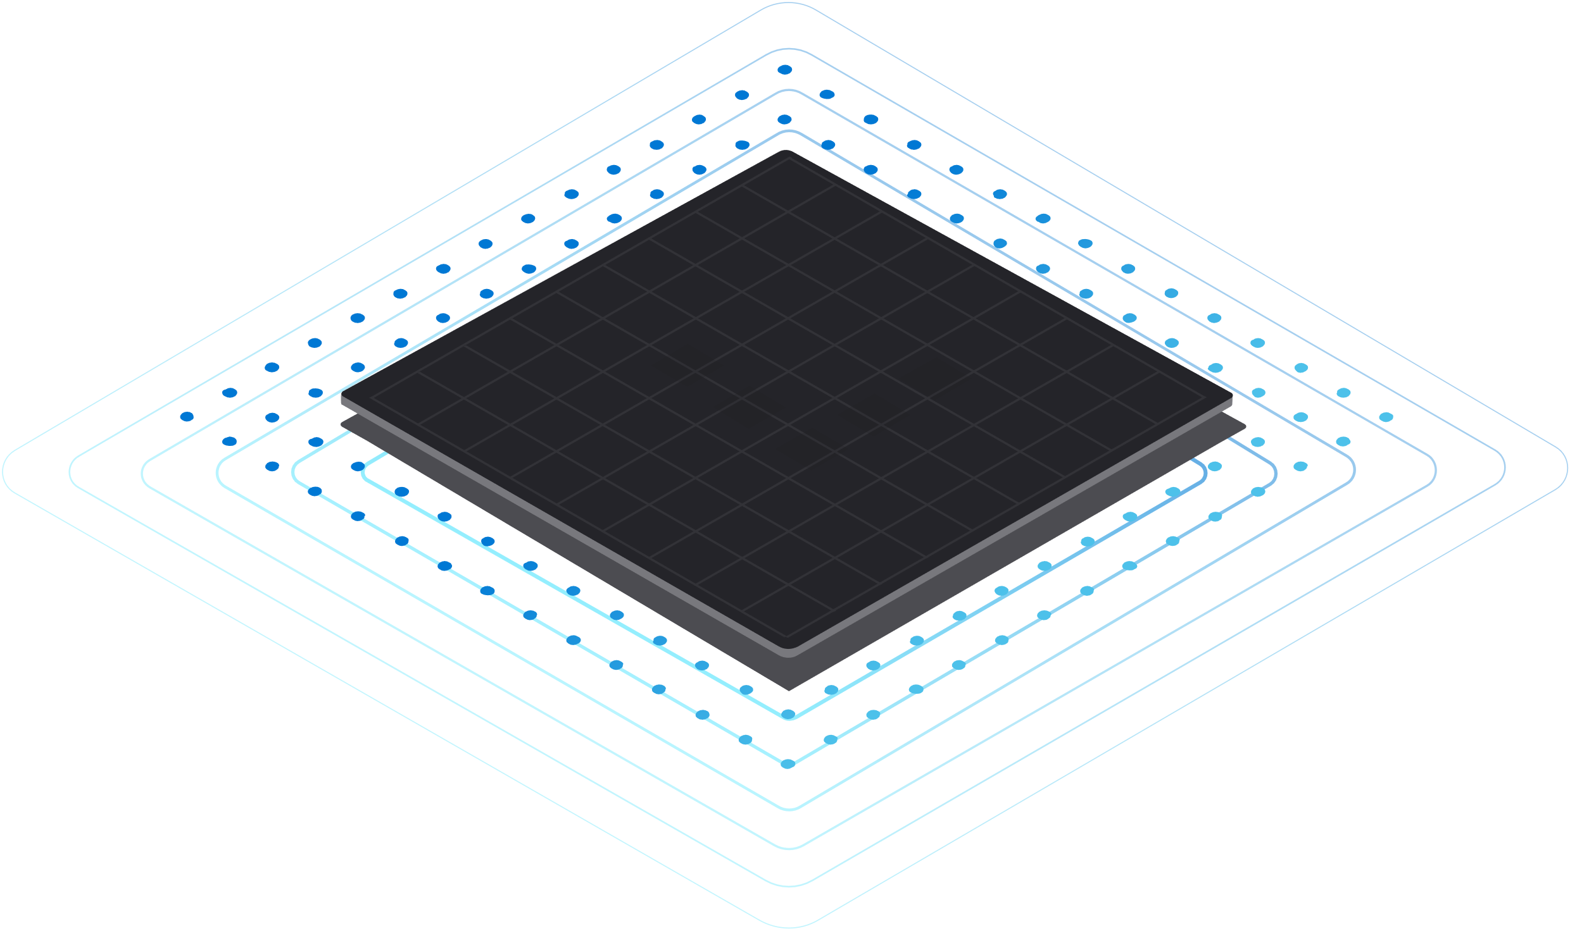
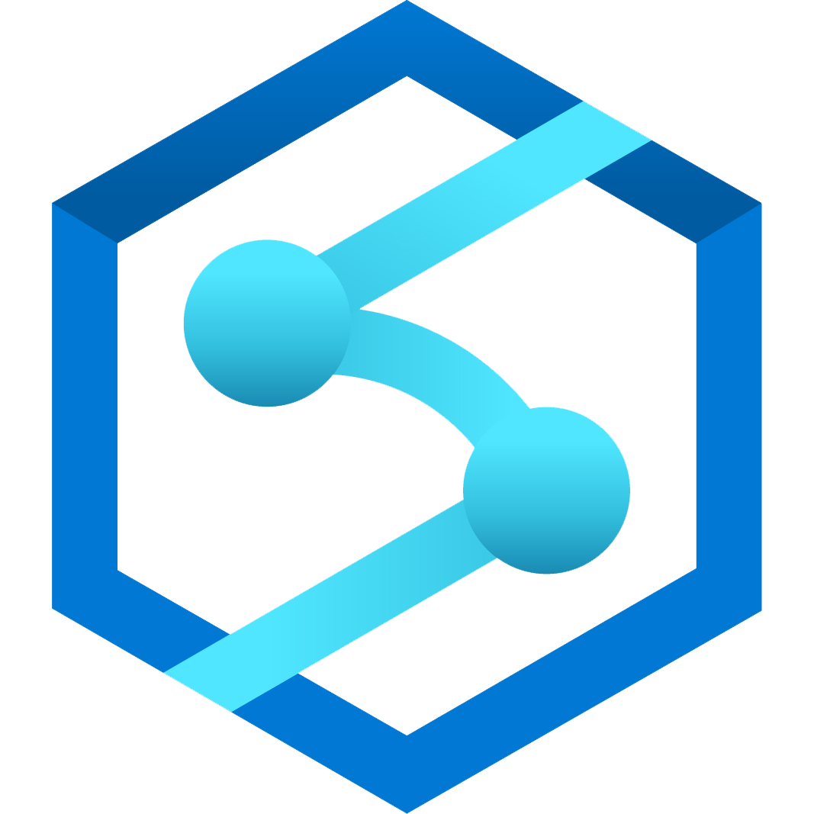

Azure Synapse Link for Azure Cosmos DB
Breaking down the barrier between OLTP & OLAP
Azure Synapse
1
Azure
Cosmos DB
Near real-time data analytics
No performance impact on transactional workloads
No ETL required
Notes:
We’re excited to announce Azure Synapse Link for Azure Cosmos DB as a cloud-native hybrid transactional and analytical processing (HTAP) capability that enables you to analytics over operational data in Azure Cosmos DB with no ETL and no performance impact on your transactional workloads. Azure Synapse Link finally breaks down the barrier that has long existed between the OLTP and OLAP systems.
You can now generate near real-time analytics over your operational data in Cosmos DB at scale…. With a ‘Single click’

Slide 8





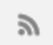

Azure Synapse Link : How it works?
Transactional Store
Row store optimized for transactional operations
Analytical Store
Column store optimized for analytical queries
Machine learning
Container
Operational
Data
Cloud-Native HTAP
Big data analytics
Auto-Sync
Azure Synapse Link
SQL
BI Dashboards
Azure Cosmos DB
Azure Synapse Analytics
Generate near real-time insights on your operational data
Notes:
So what’s the magic powering Synapse Link?
First animation:
So far, your operational data in Cosmos DB is internally stored in a row-oriented ‘transactional store’. This store is optimized for transactional reads/writes & operational queries.
Second animation:
Now, we’re excited to bring you a fully-managed native ‘analytical store’ within Azure Cosmos DB container. Analytical store is a fully-isolated column-oriented store, optimized for typical analytical queries over large volumes of data.
Your inserts, updates, deletes to operational data are automatically synced from transactional store to analytical store in near real-time within minutes. This ‘auto-sync’ capability does not consume RUs allocated for your operational workloads.
Third animation:
Now with Synapse Link, you can connect Cosmos DB Analytical store with Synapse Analytics with a ‘single click’. This allows you to interchangeably query operational data in Cosmos DB using Spark & SQL runtimes.
This enables you to build machine learning pipelines, BI dashboards and run big-data analytics in near real-time on your operational data.

Slide 9
DEMO
Notes:
DEMO

Slide 10

Scenario
A retailer looking to build their new-age supply chain management platform on Azure Cosmos DB
The supply chain management system tracks retail operations across 1000s of locations across the world and tracks inventory across the 100s of product SKUs sold
Let us explore how Synapse Link for Cosmos DB enables the following operational analytics scenarios:
Building an end-to-end sales forecasting pipeline
Business Intelligence reporting

Slide 11
You can find more e2e samples of Synapse Link for Cosmos DB at
https://aka.ms/cosmosdb-synapselink-samples
Notes:
DEMO

Slide 12


Questions
Additional Azure Cosmos DB sessions after this
INT 125 - Building scalable and secure applications with Azure Cosmos DB
INT 166 - Develop Node.js apps with Azure Cosmos DB API for MongoDB
Additional Azure Synapse Analytics sessions after this
INT 129 - Developing end-to-end analytics solutions with the latest Azure Synapse features
INT 130 - Running cost effective big data workloads with Azure Synapse and Azure Data Lake Storage
BDL 206 - What's new with Azure Synapse Analytics
@AzureCosmosDB
youtube.com/azurecosmosdb

Slide 13
Walk-through
Notes:
DEMO

Slide 14
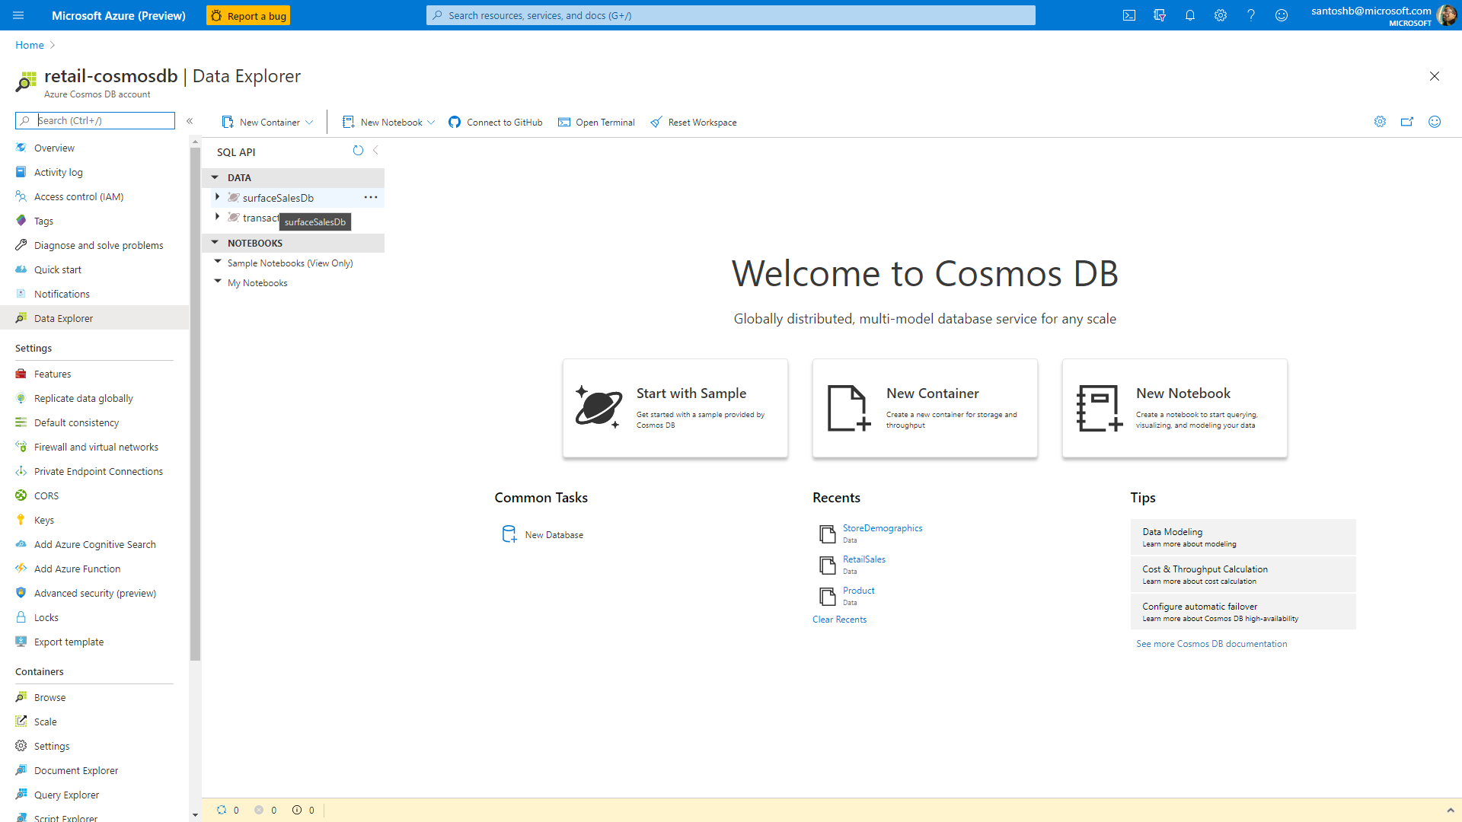

Slide 15
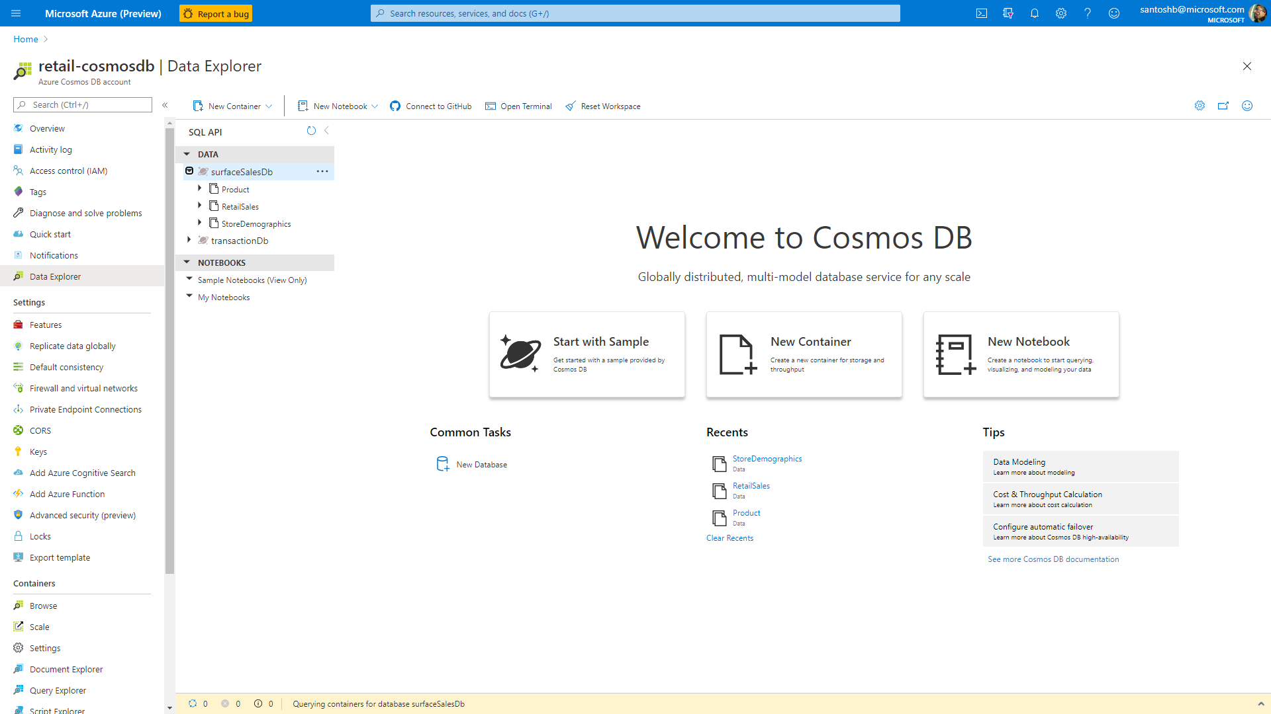

Slide 16
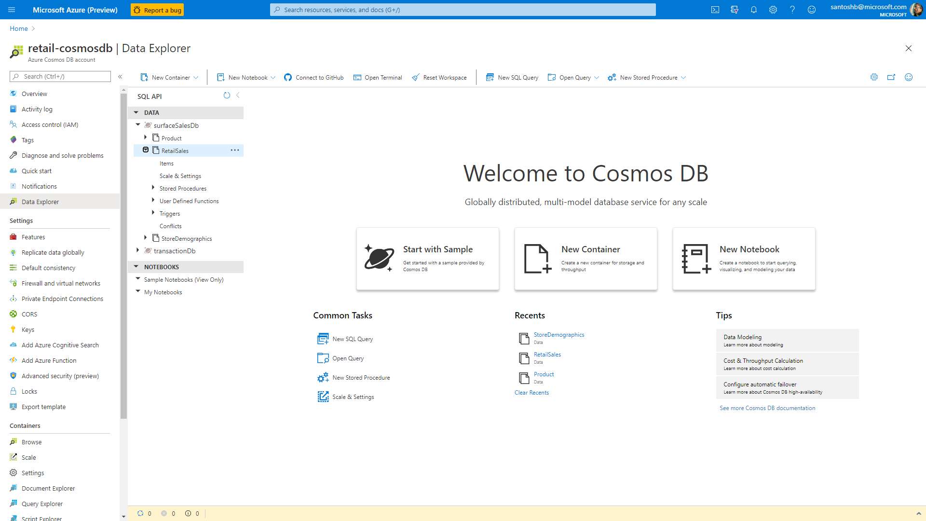

Slide 17
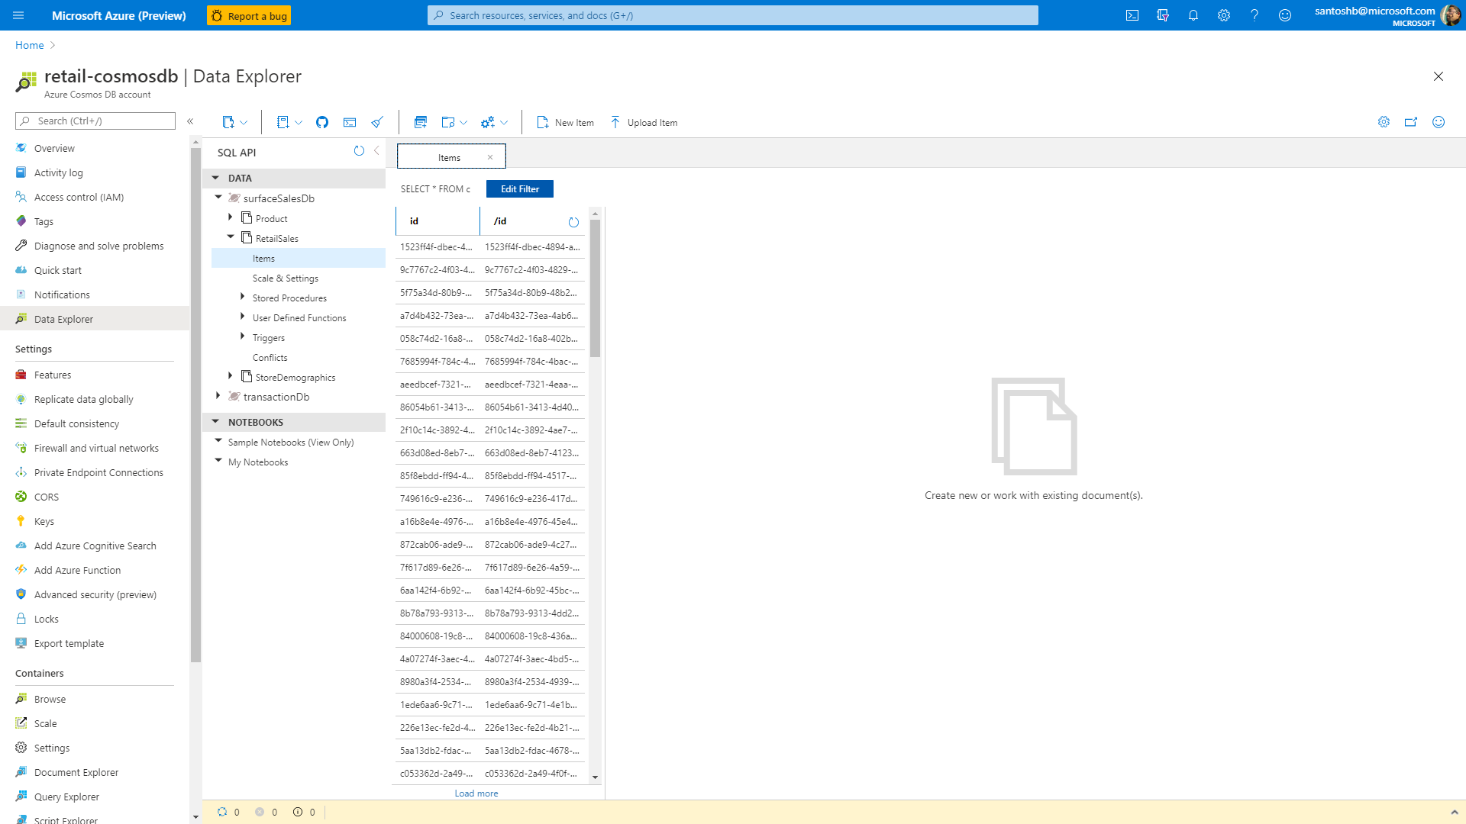

Slide 18
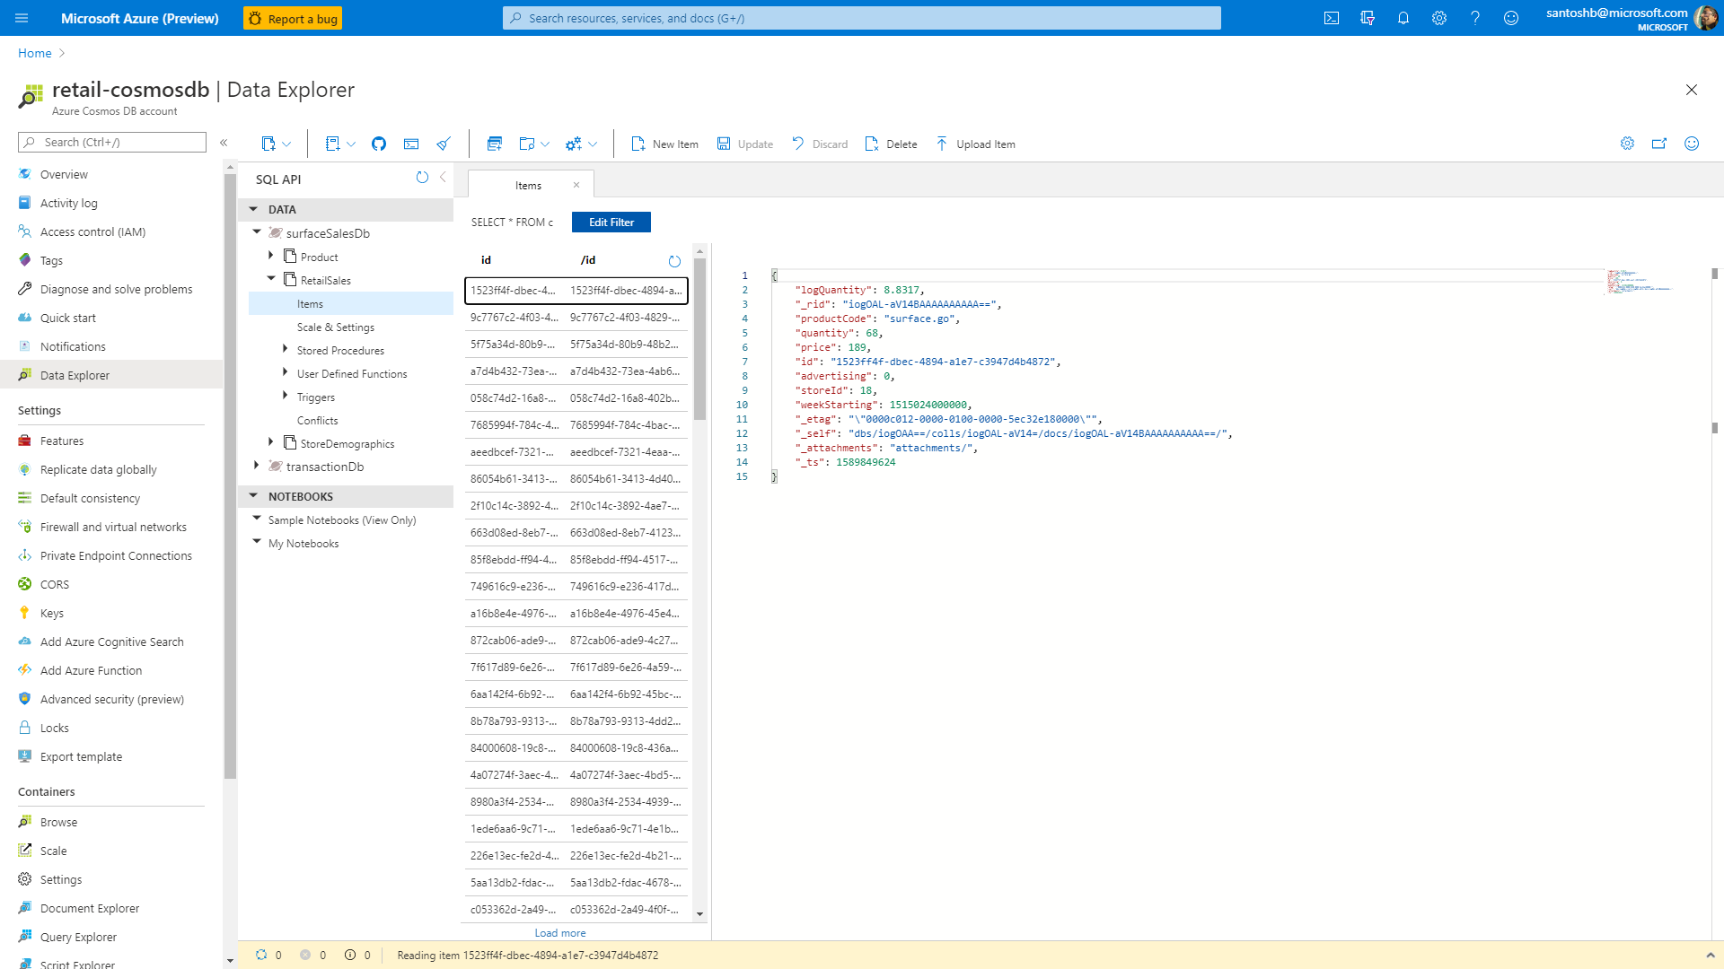

Slide 19
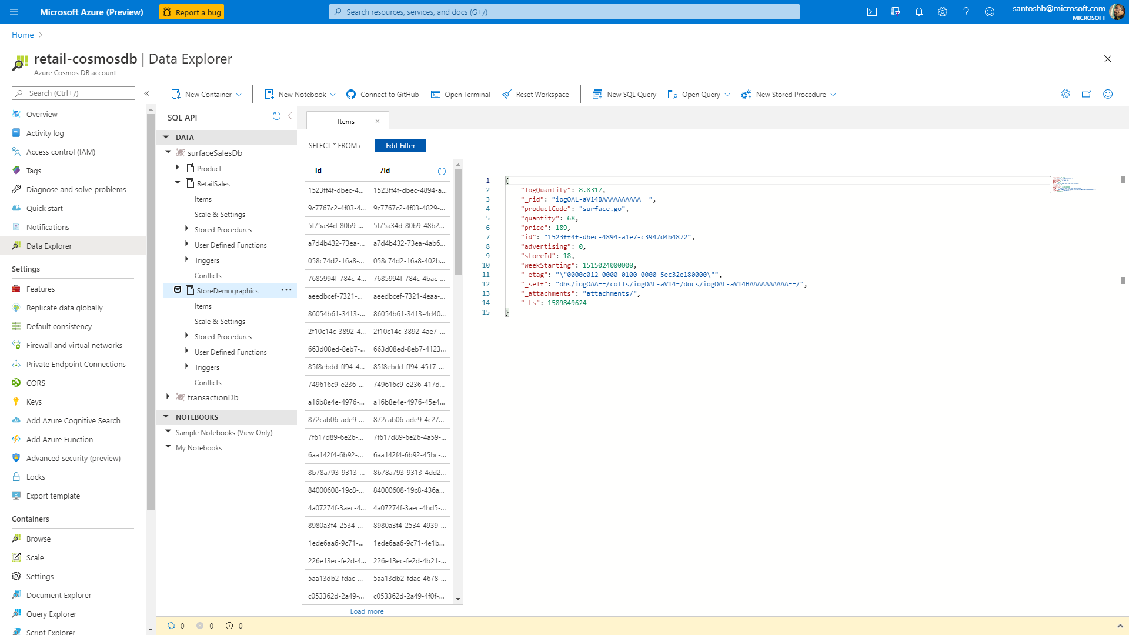

Slide 20
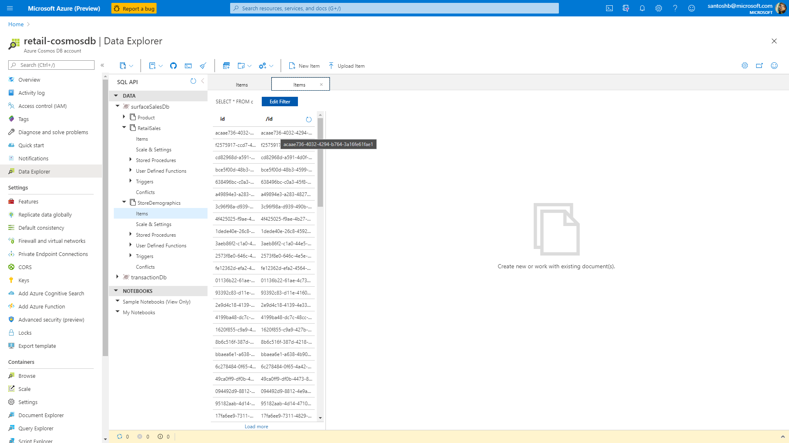

Slide 21
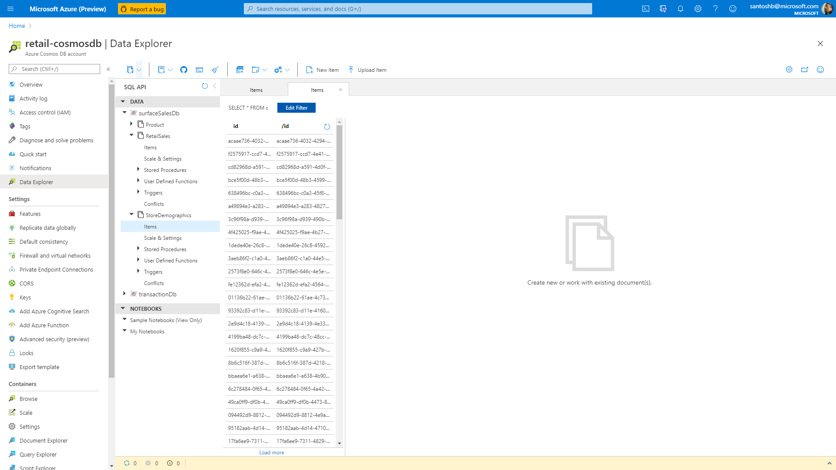

Slide 22


Slide 23
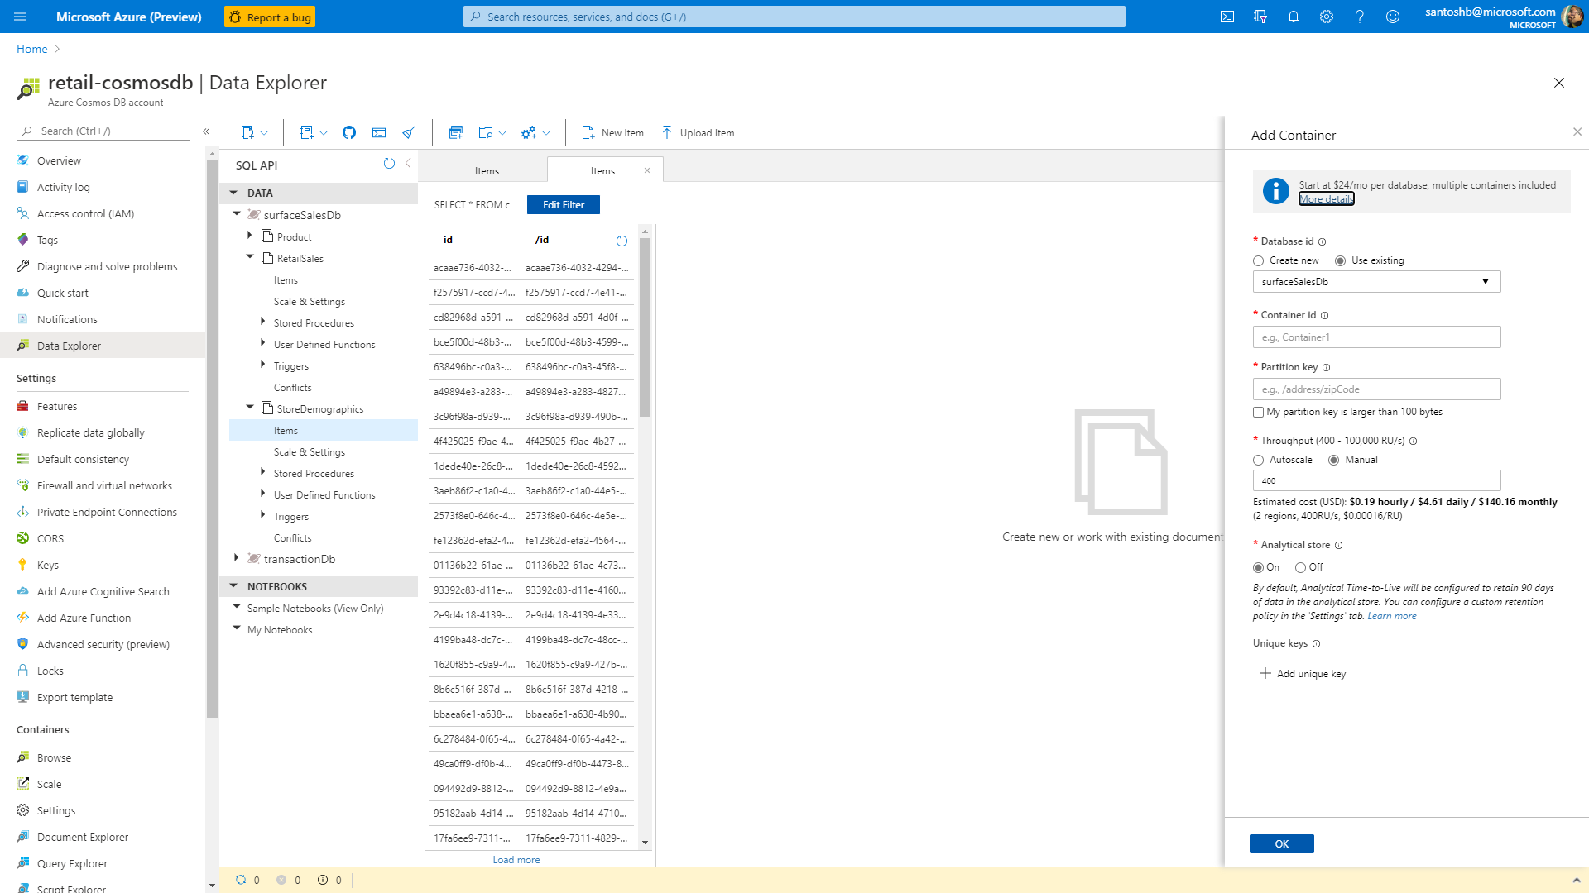

Slide 24
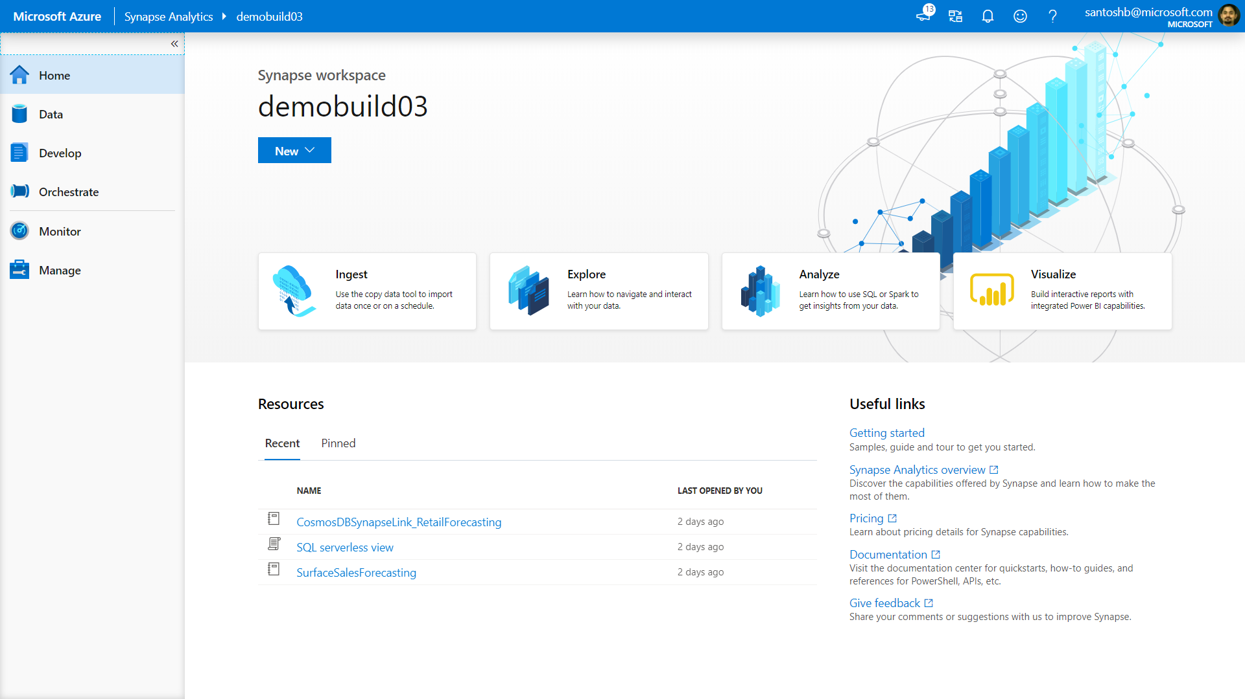

Slide 25
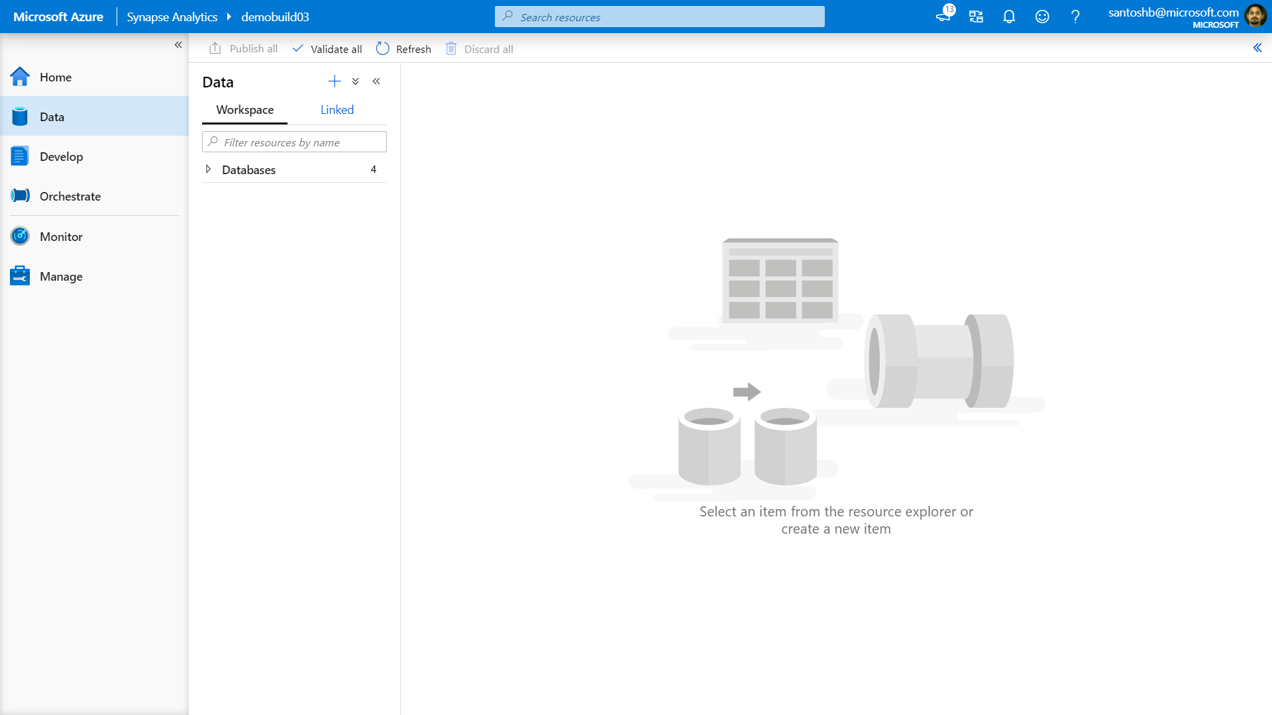

Slide 26
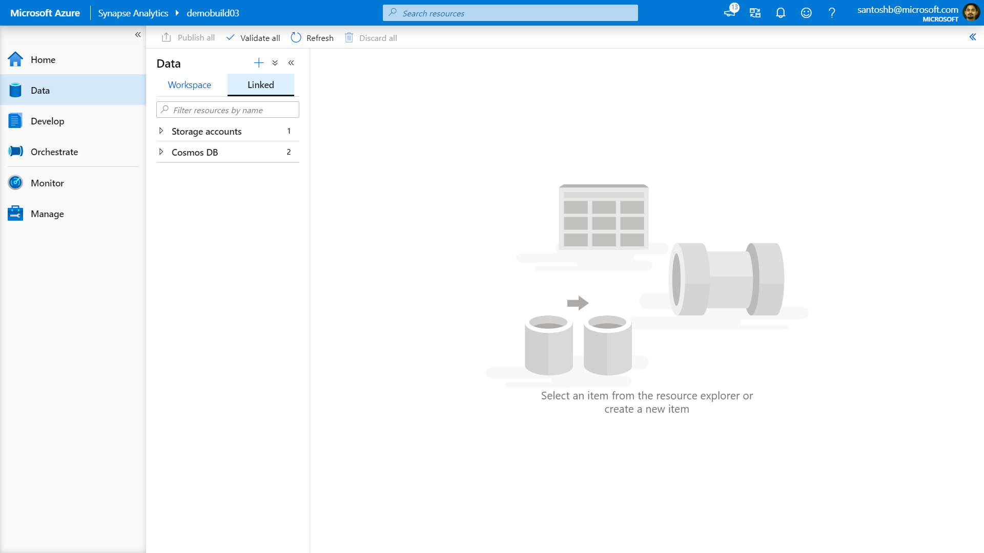

Slide 27
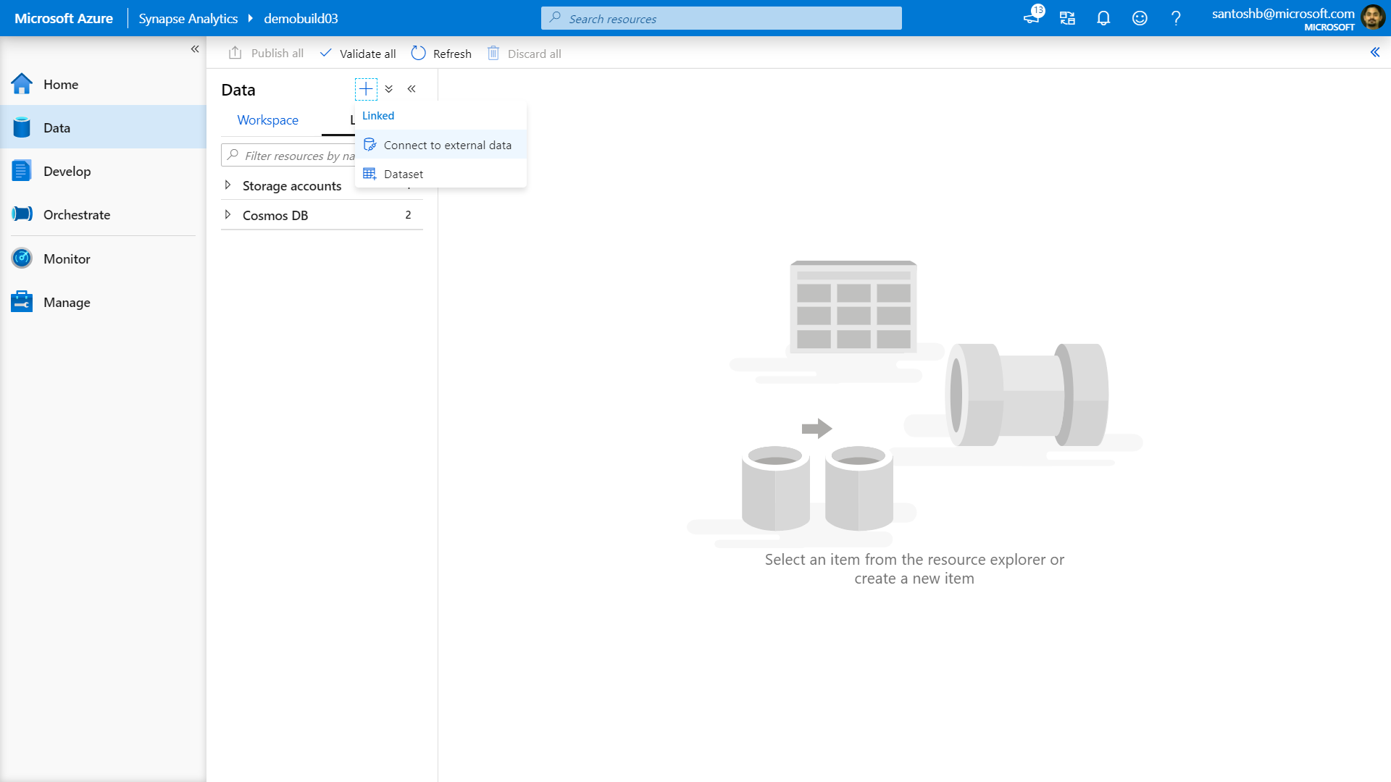

Slide 28
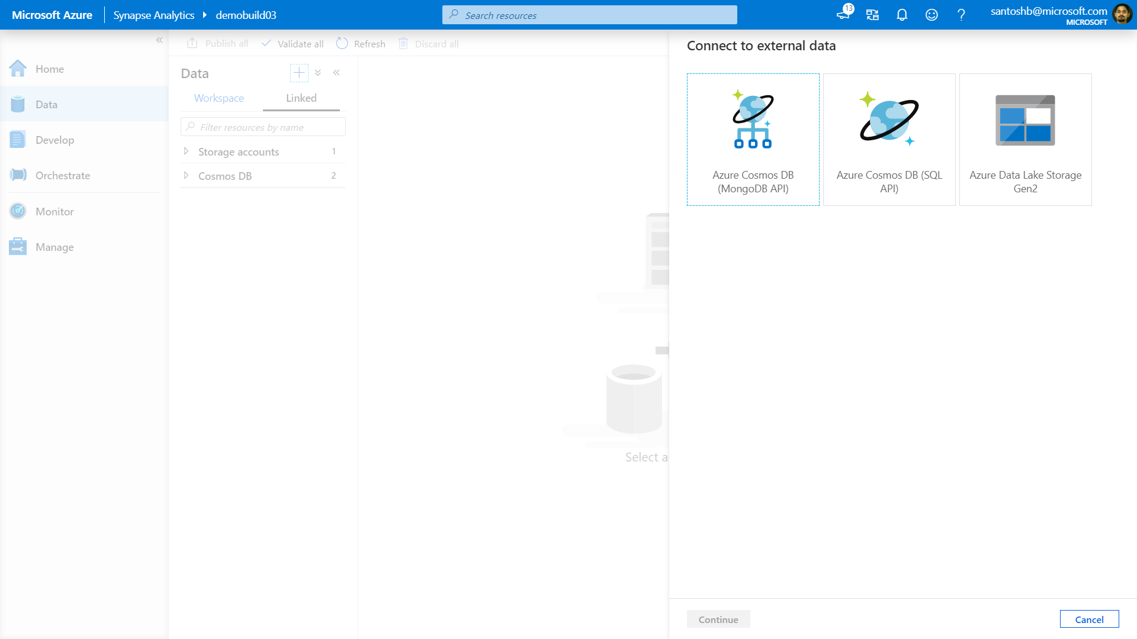

Slide 29
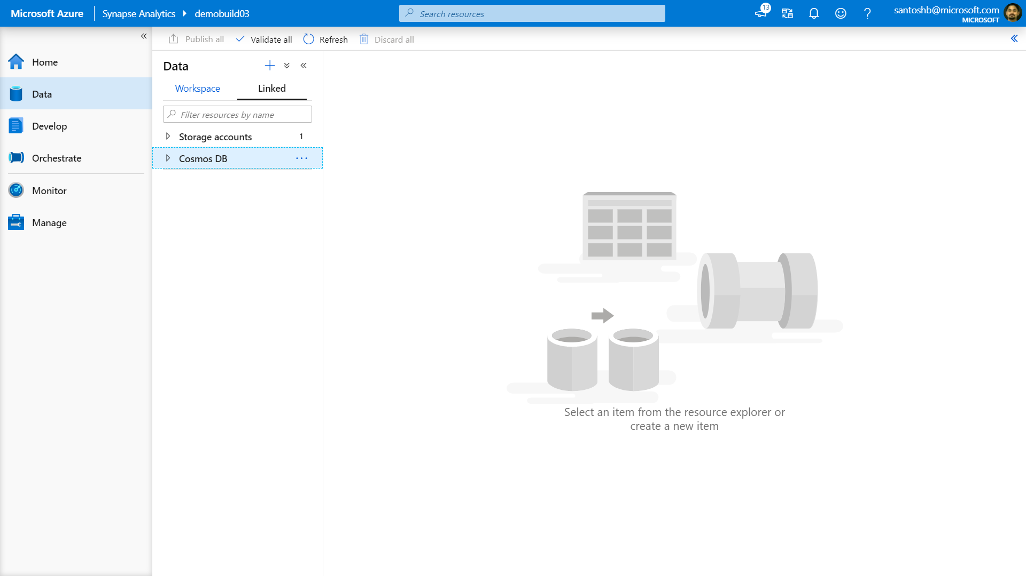

Slide 30
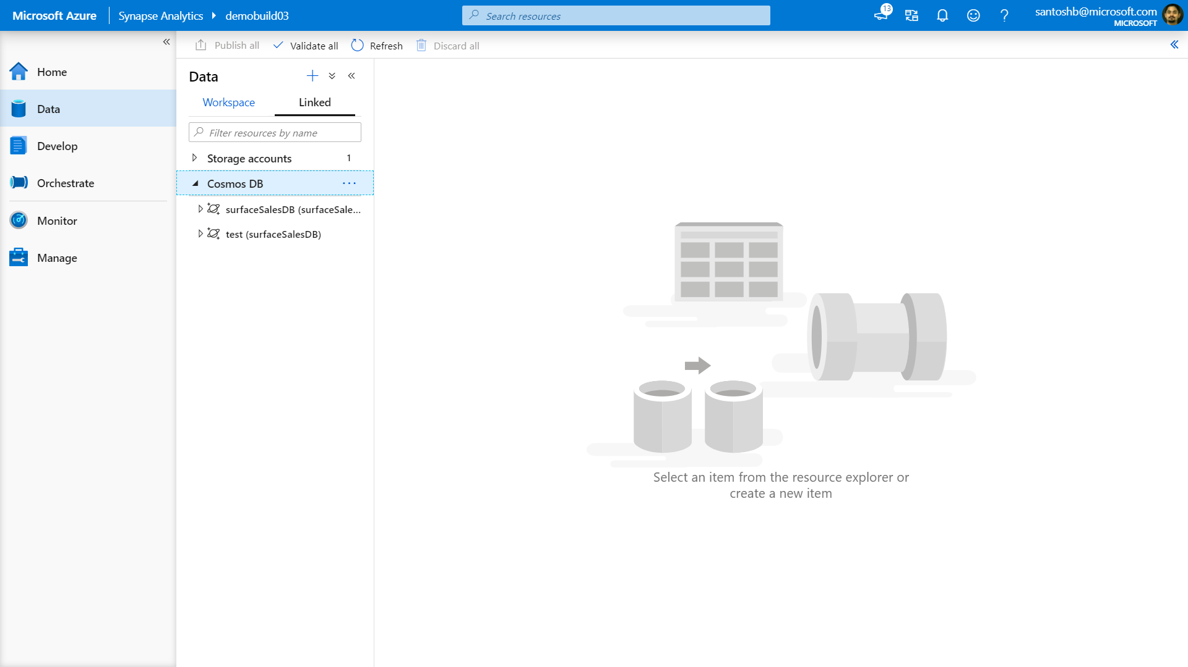

Slide 32
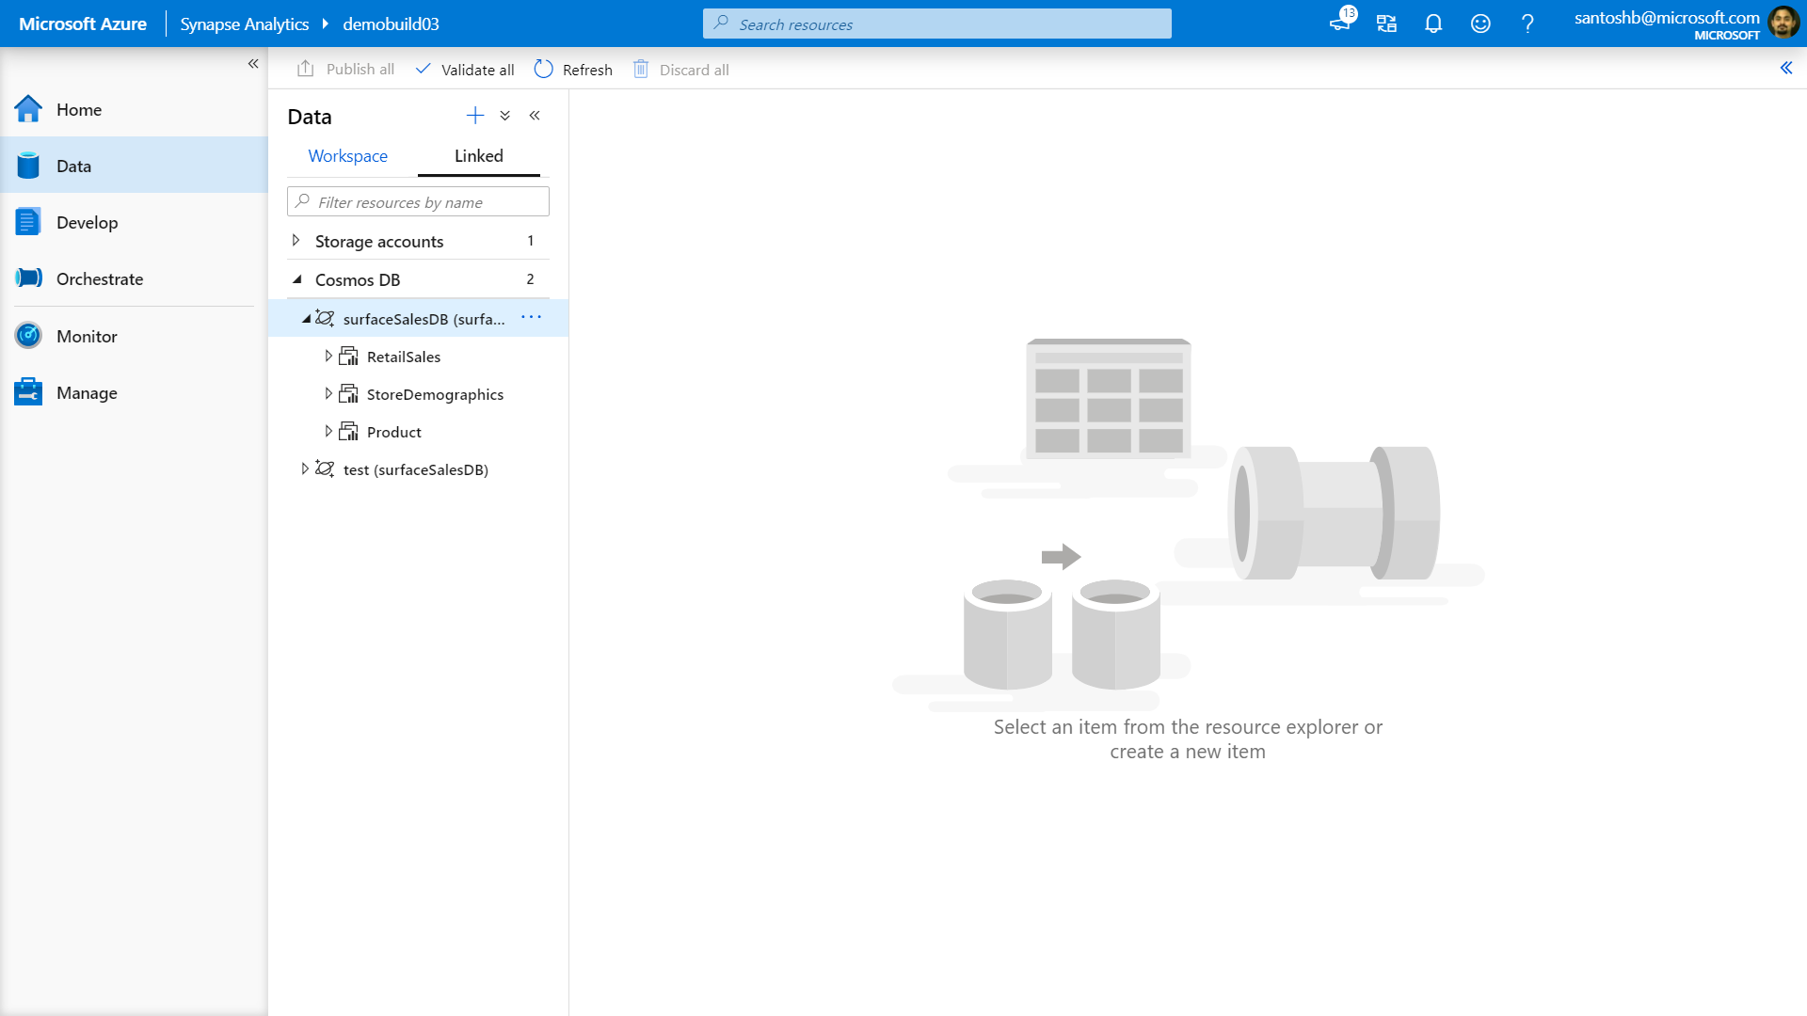

Slide 33
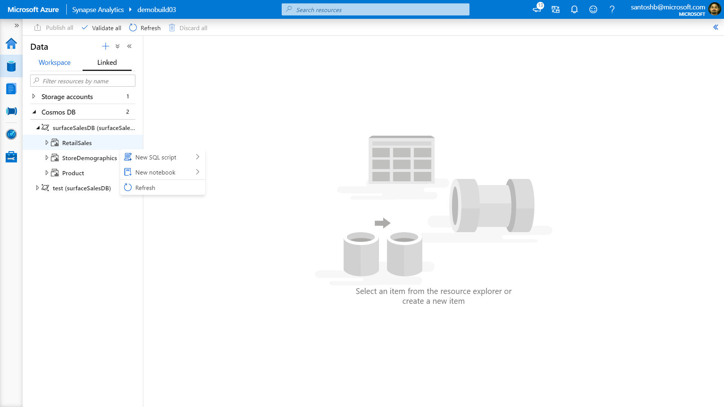

Slide 34
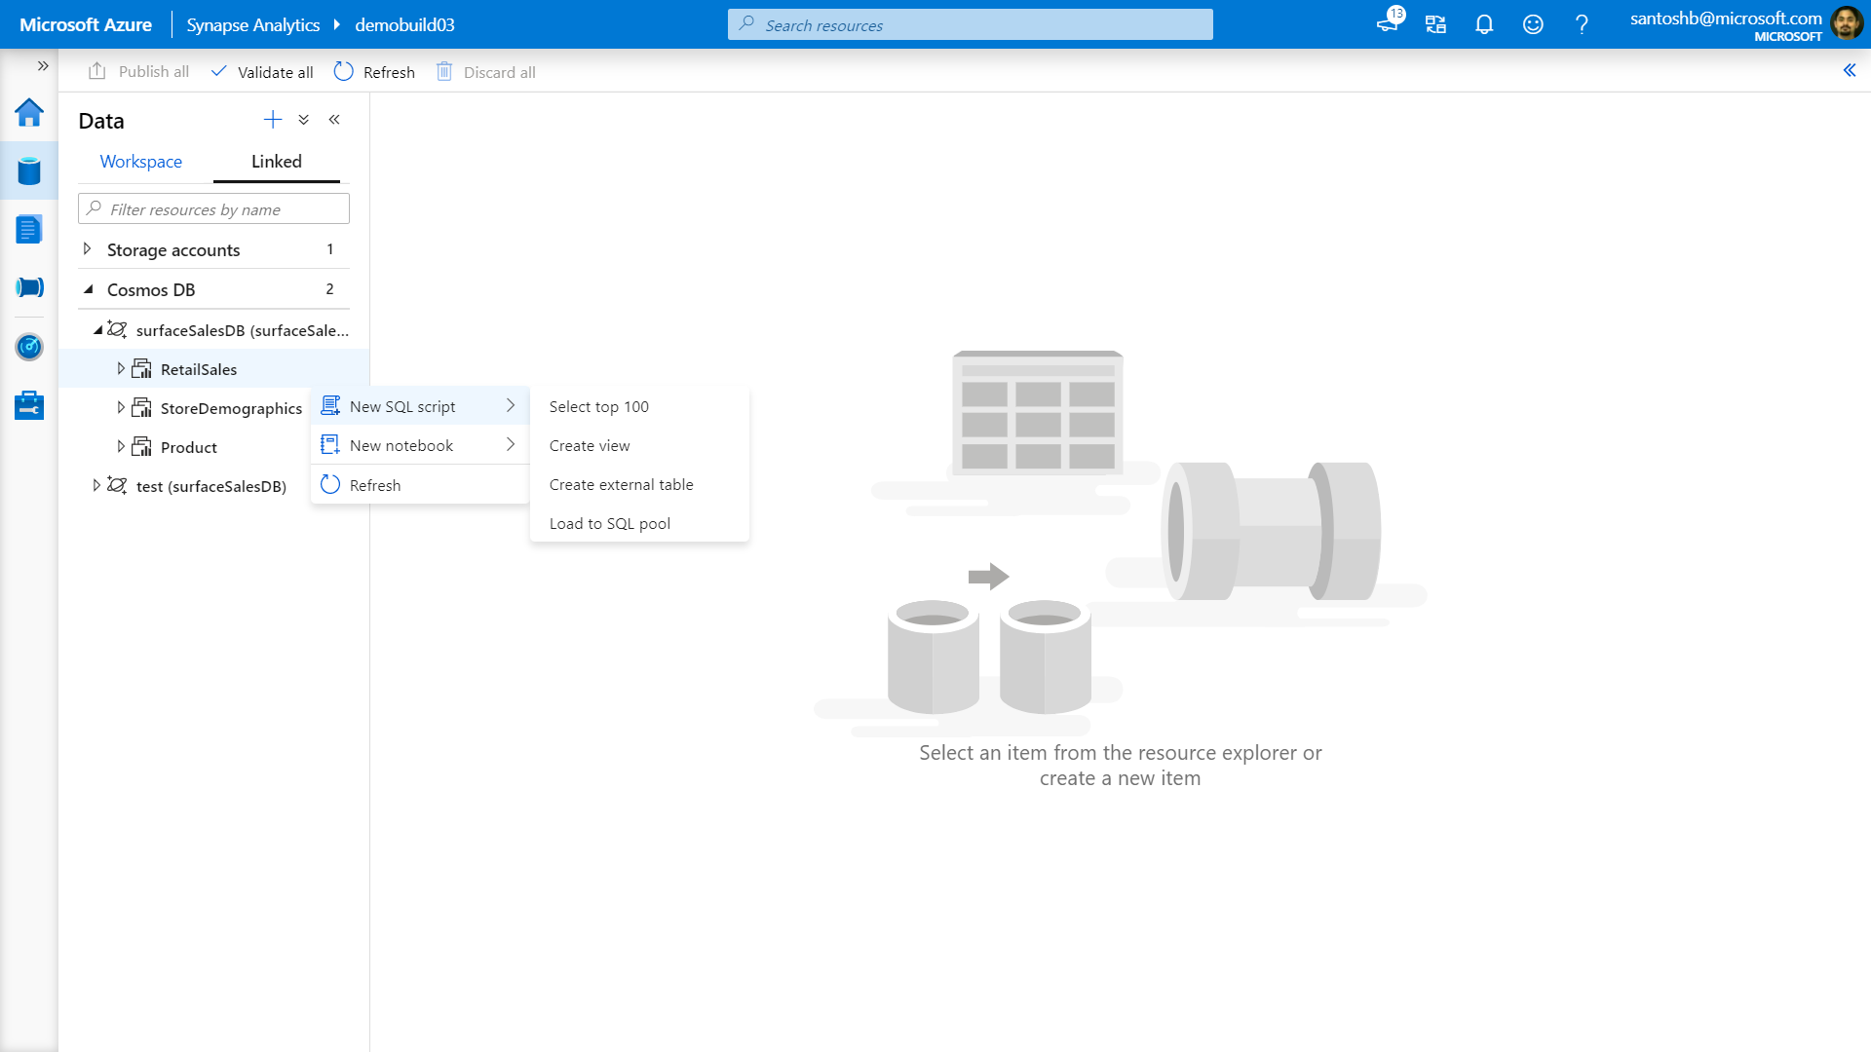

Slide 35
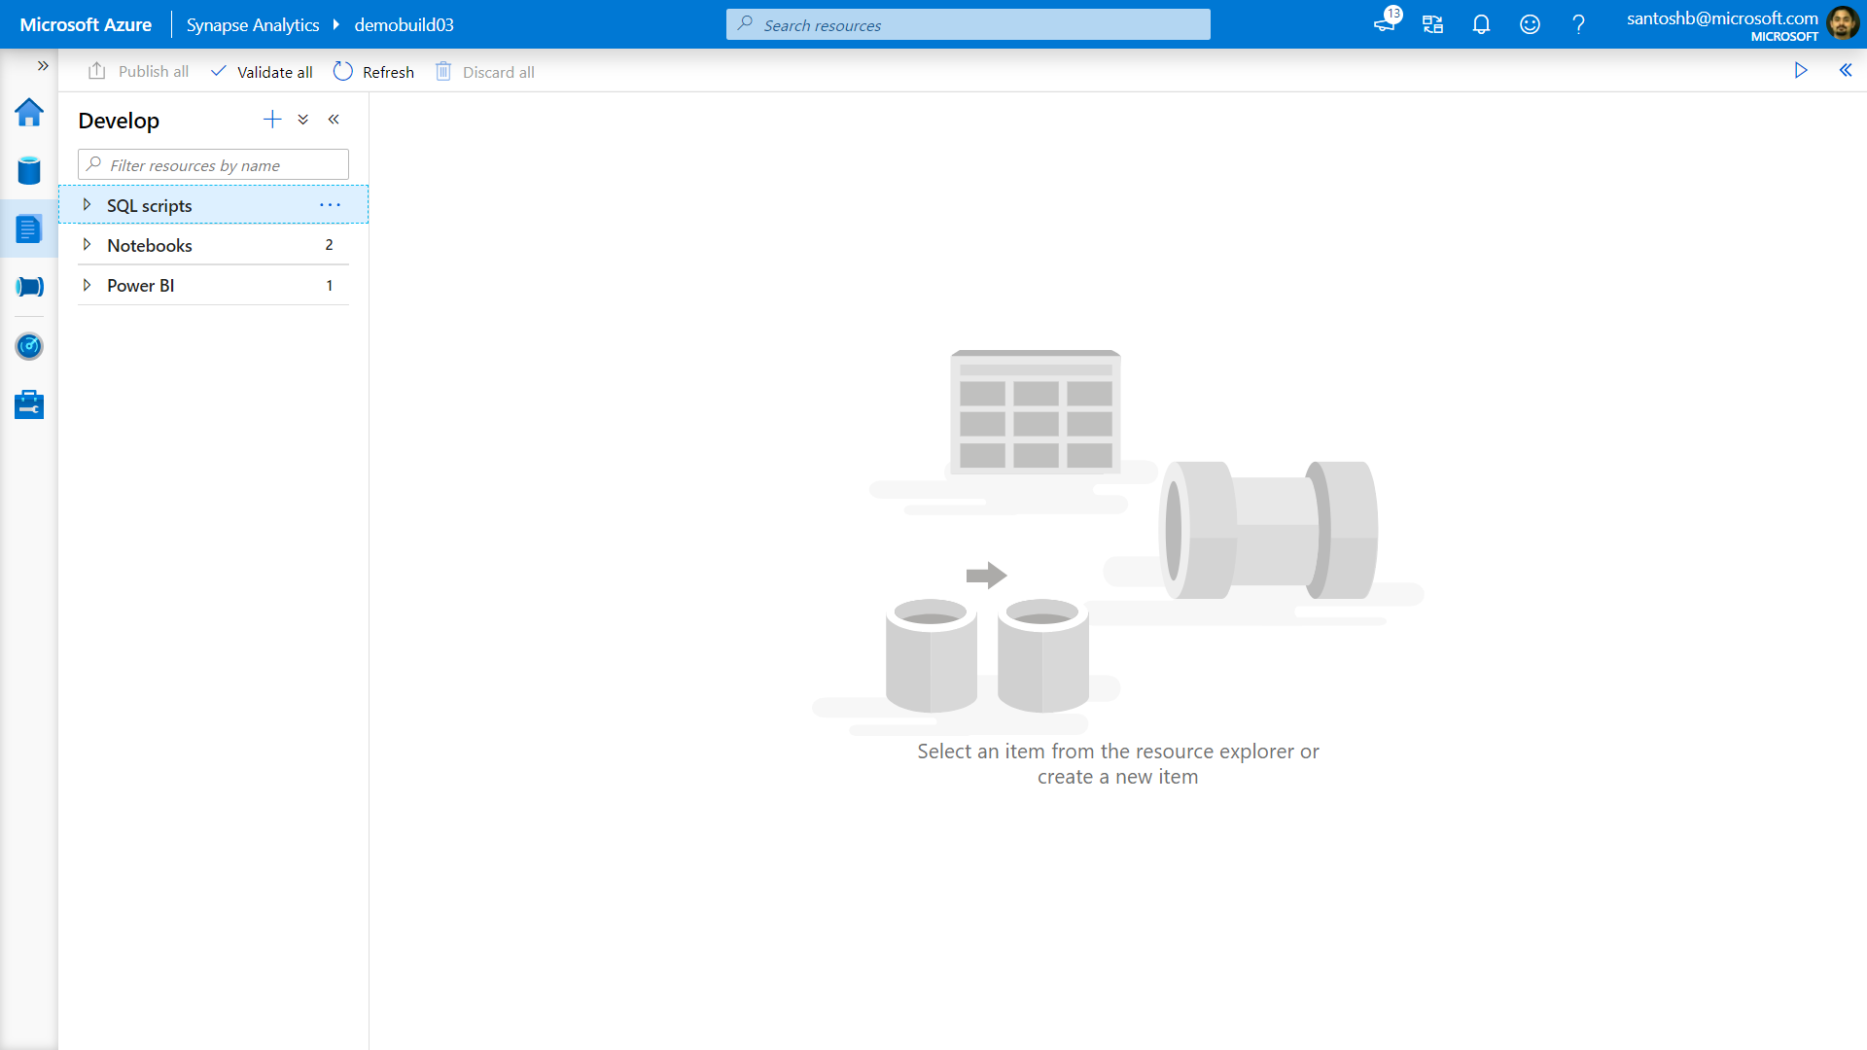

Slide 36
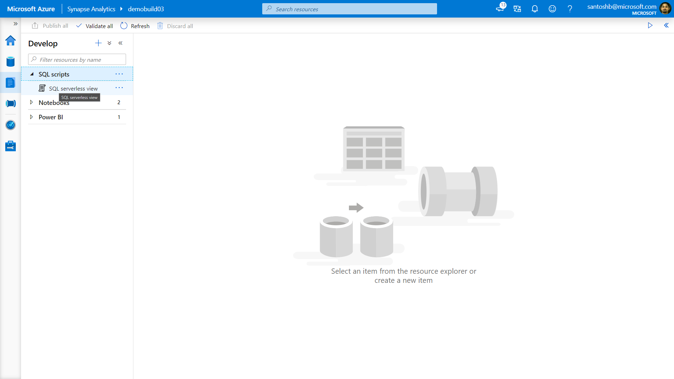

Slide 37
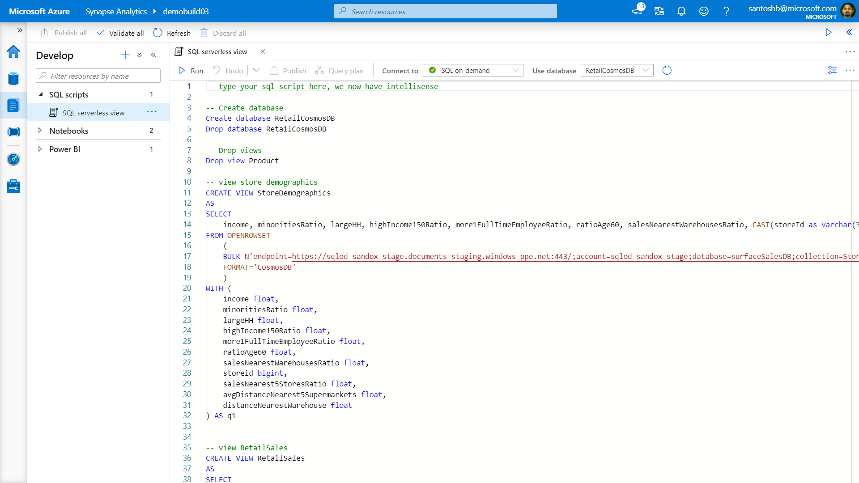

Slide 38
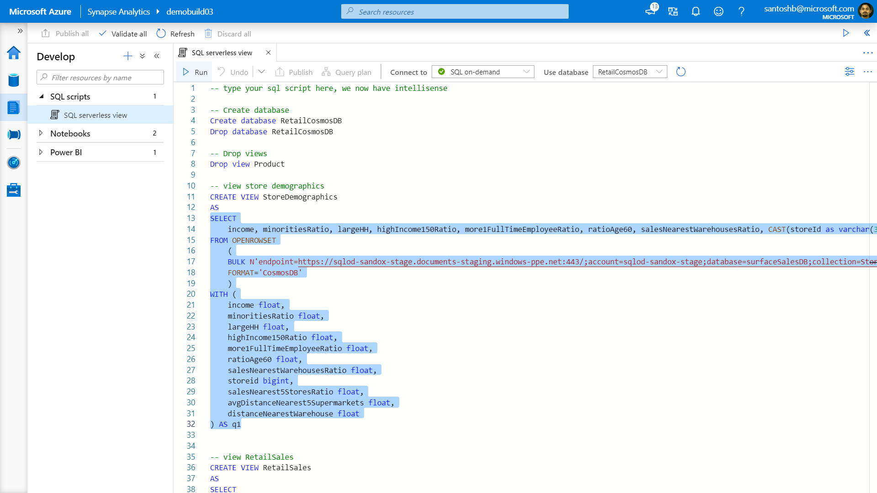

Slide 39
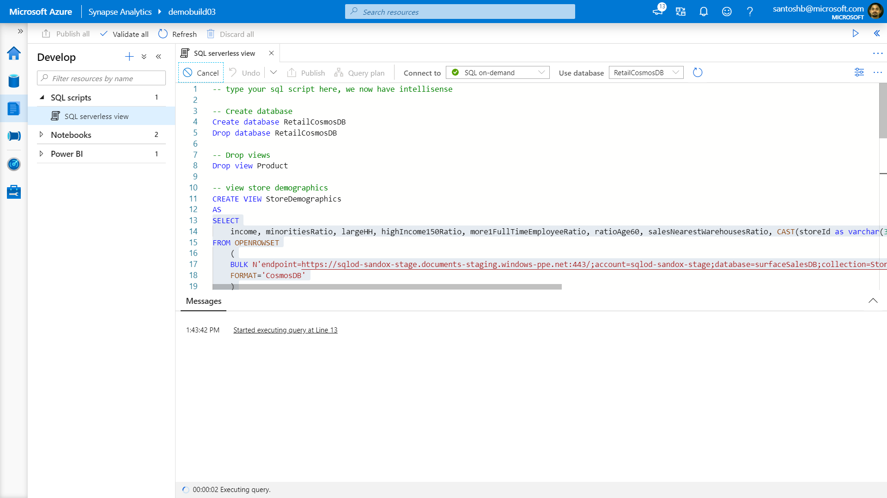

Slide 40
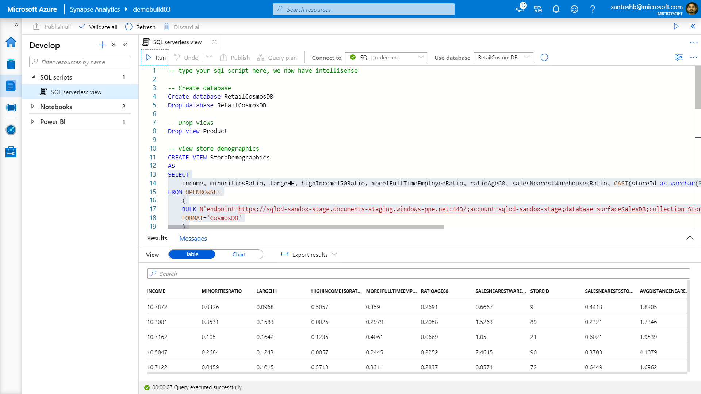

Slide 41
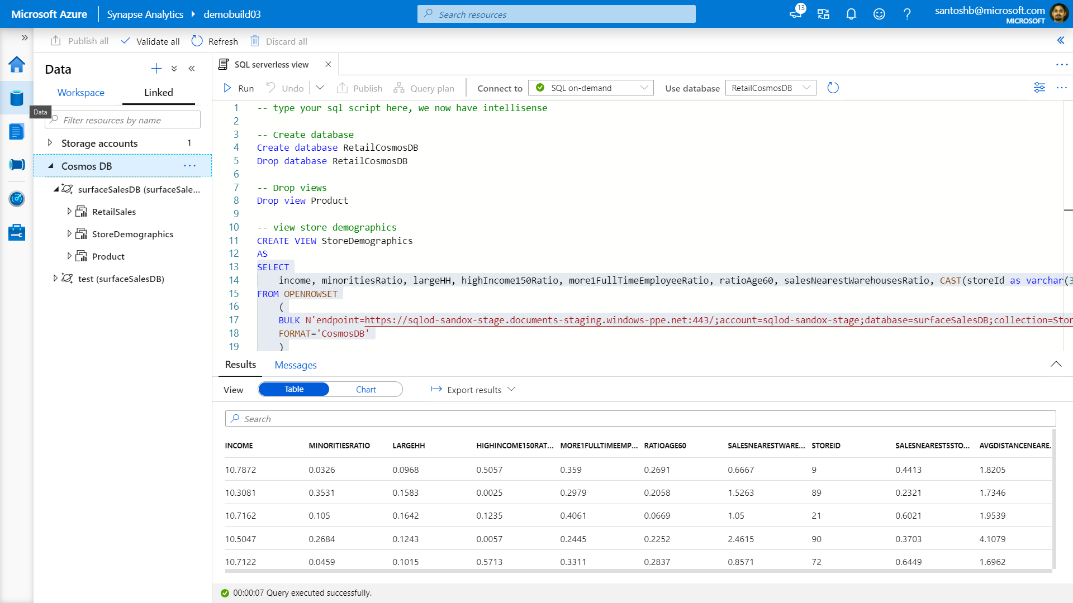

Slide 42
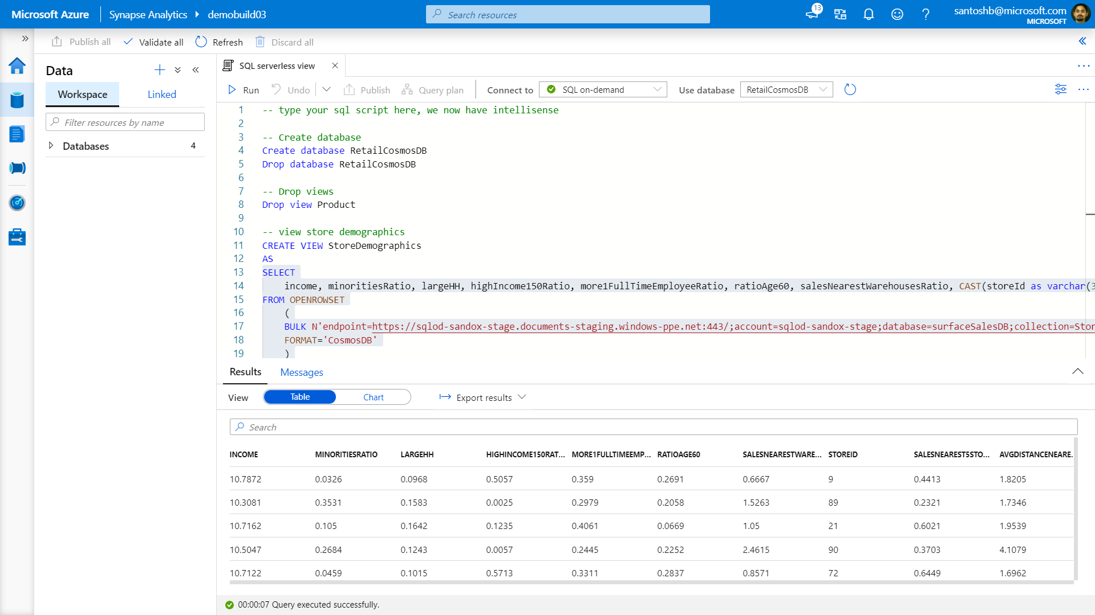

Slide 43
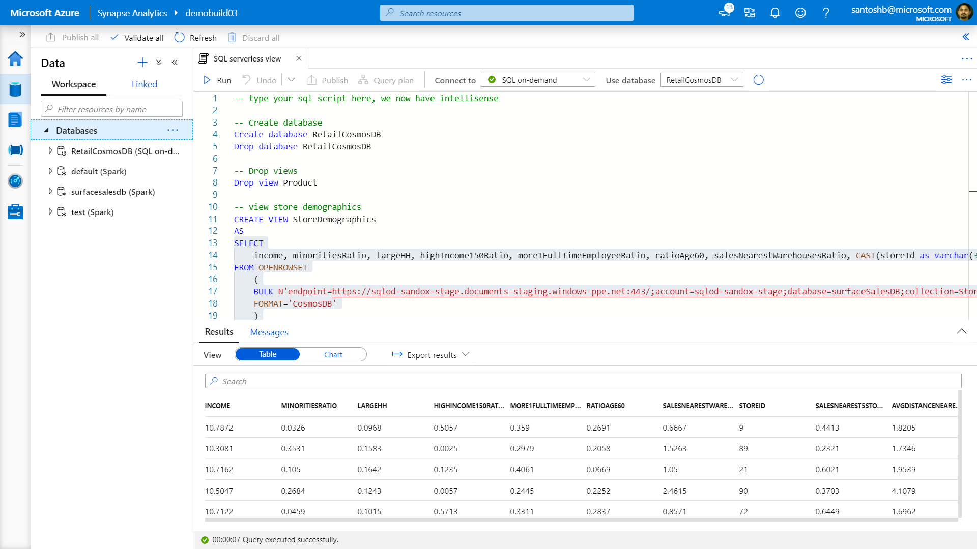

Slide 44
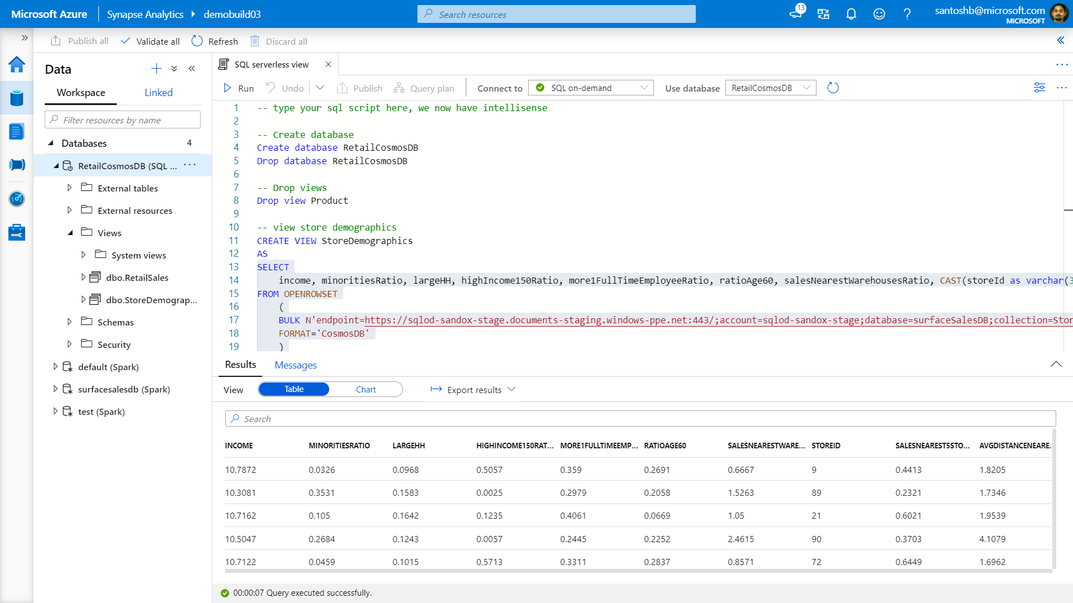

Slide 45
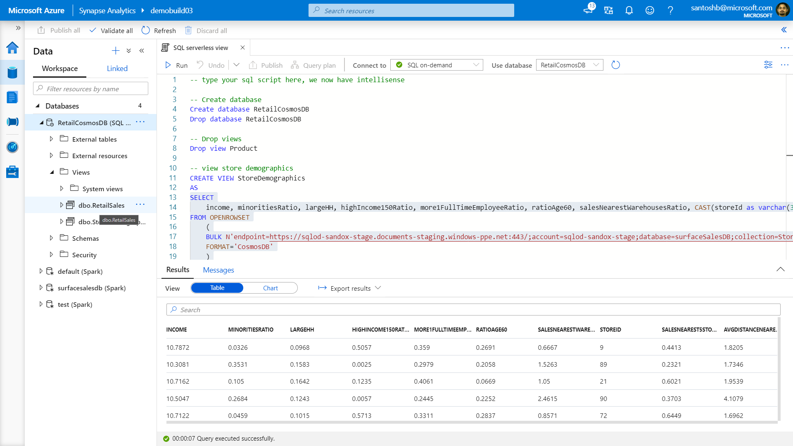

Slide 46
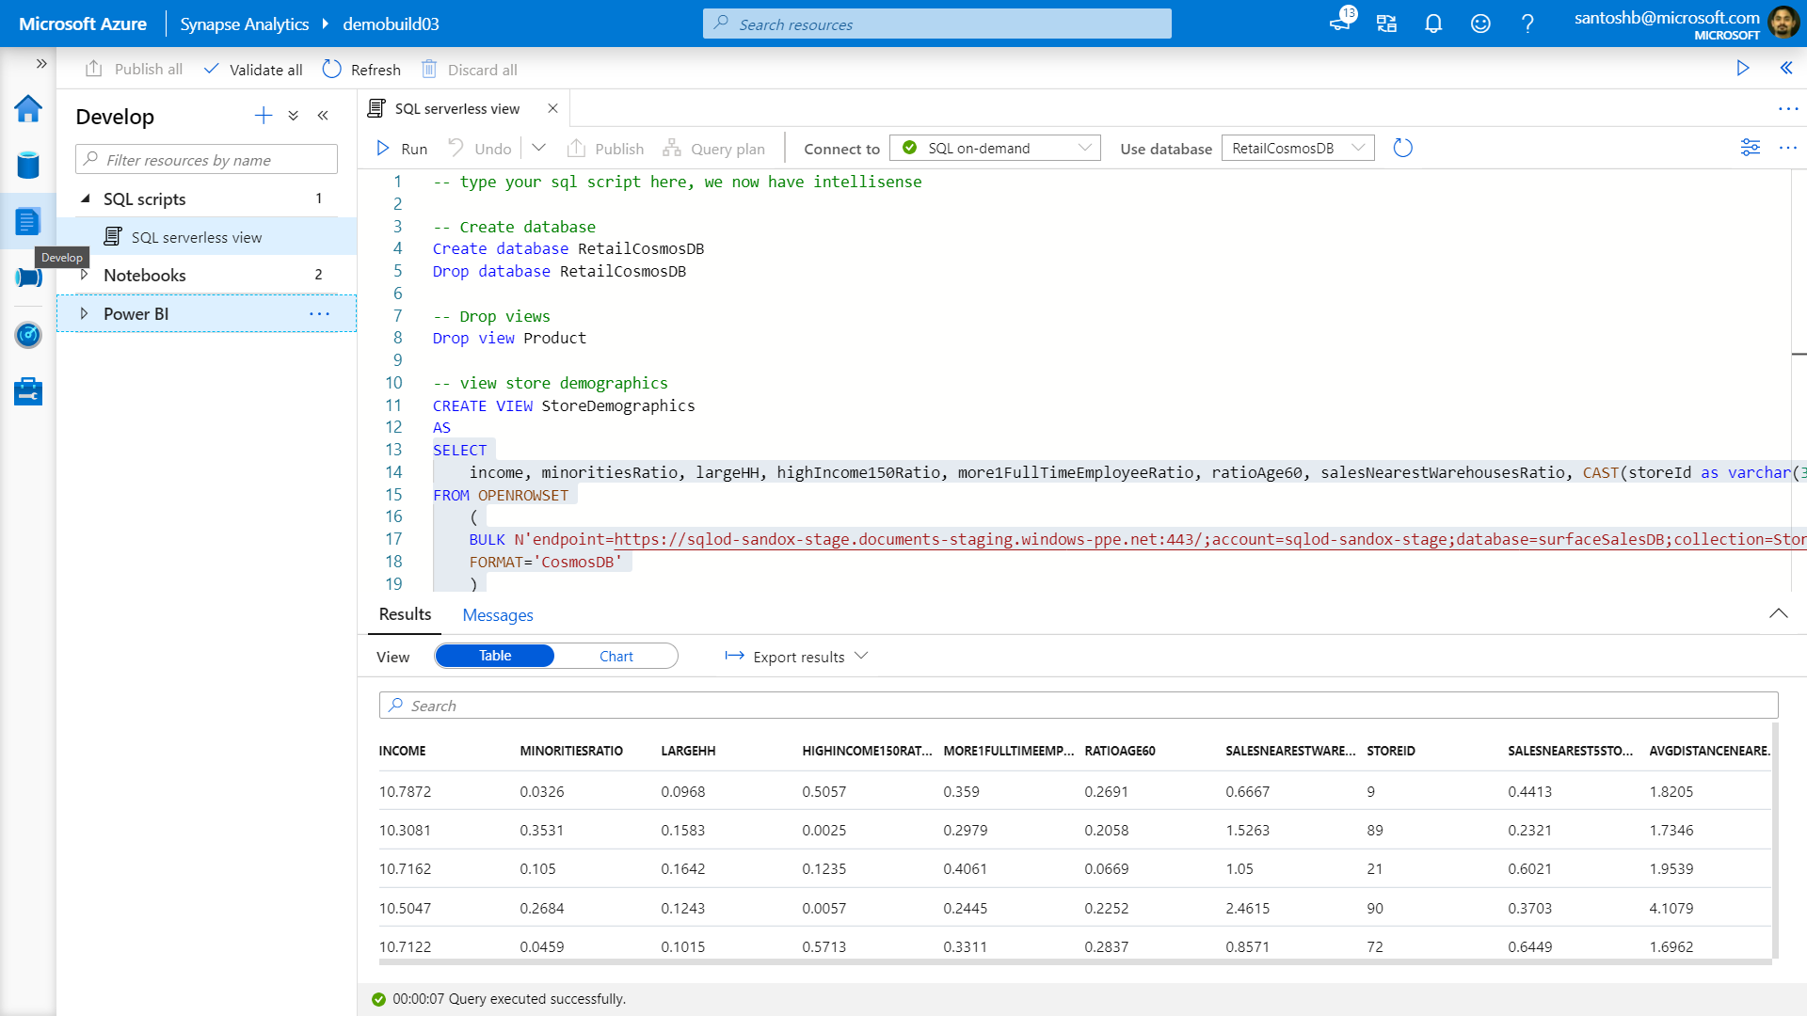

Slide 47
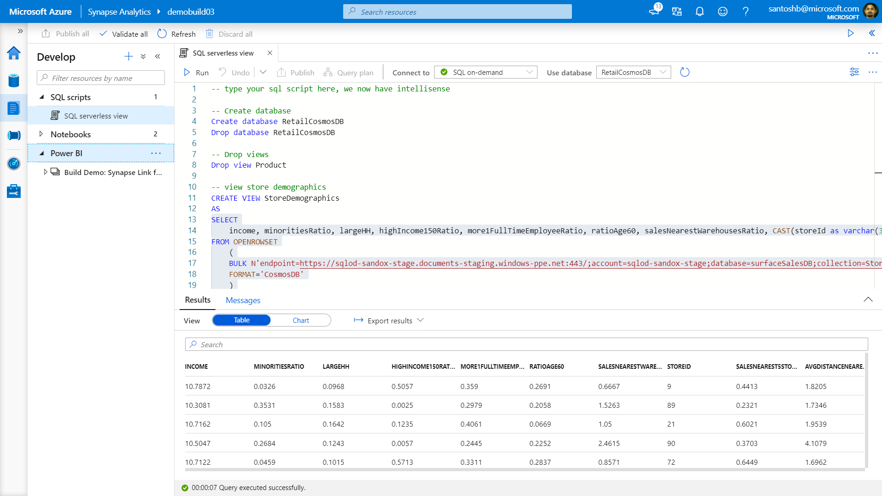

Slide 48
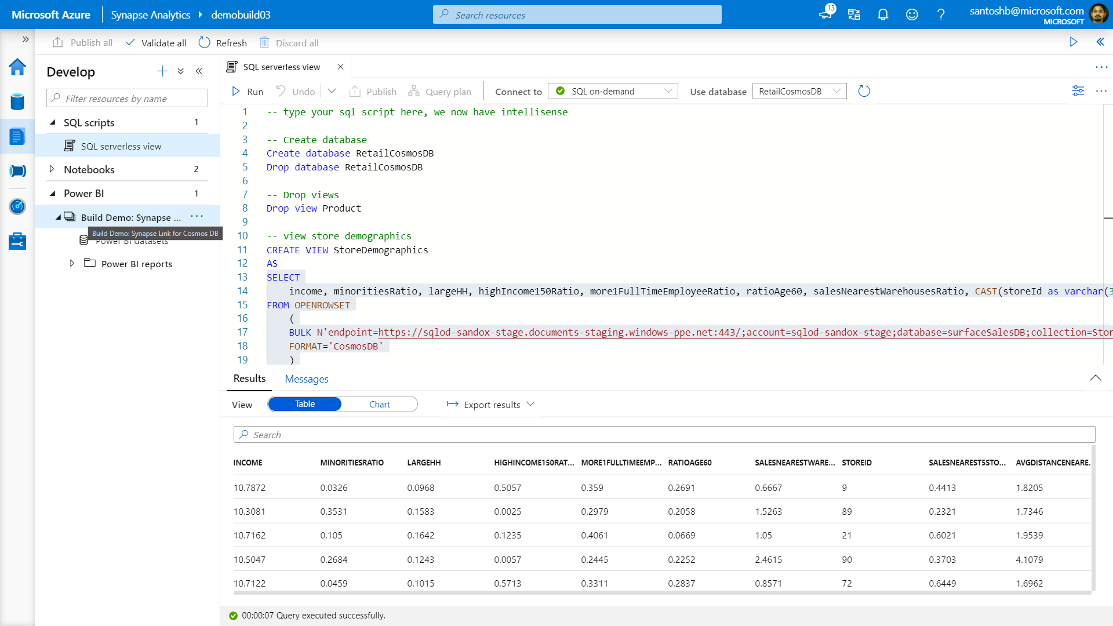

Slide 49
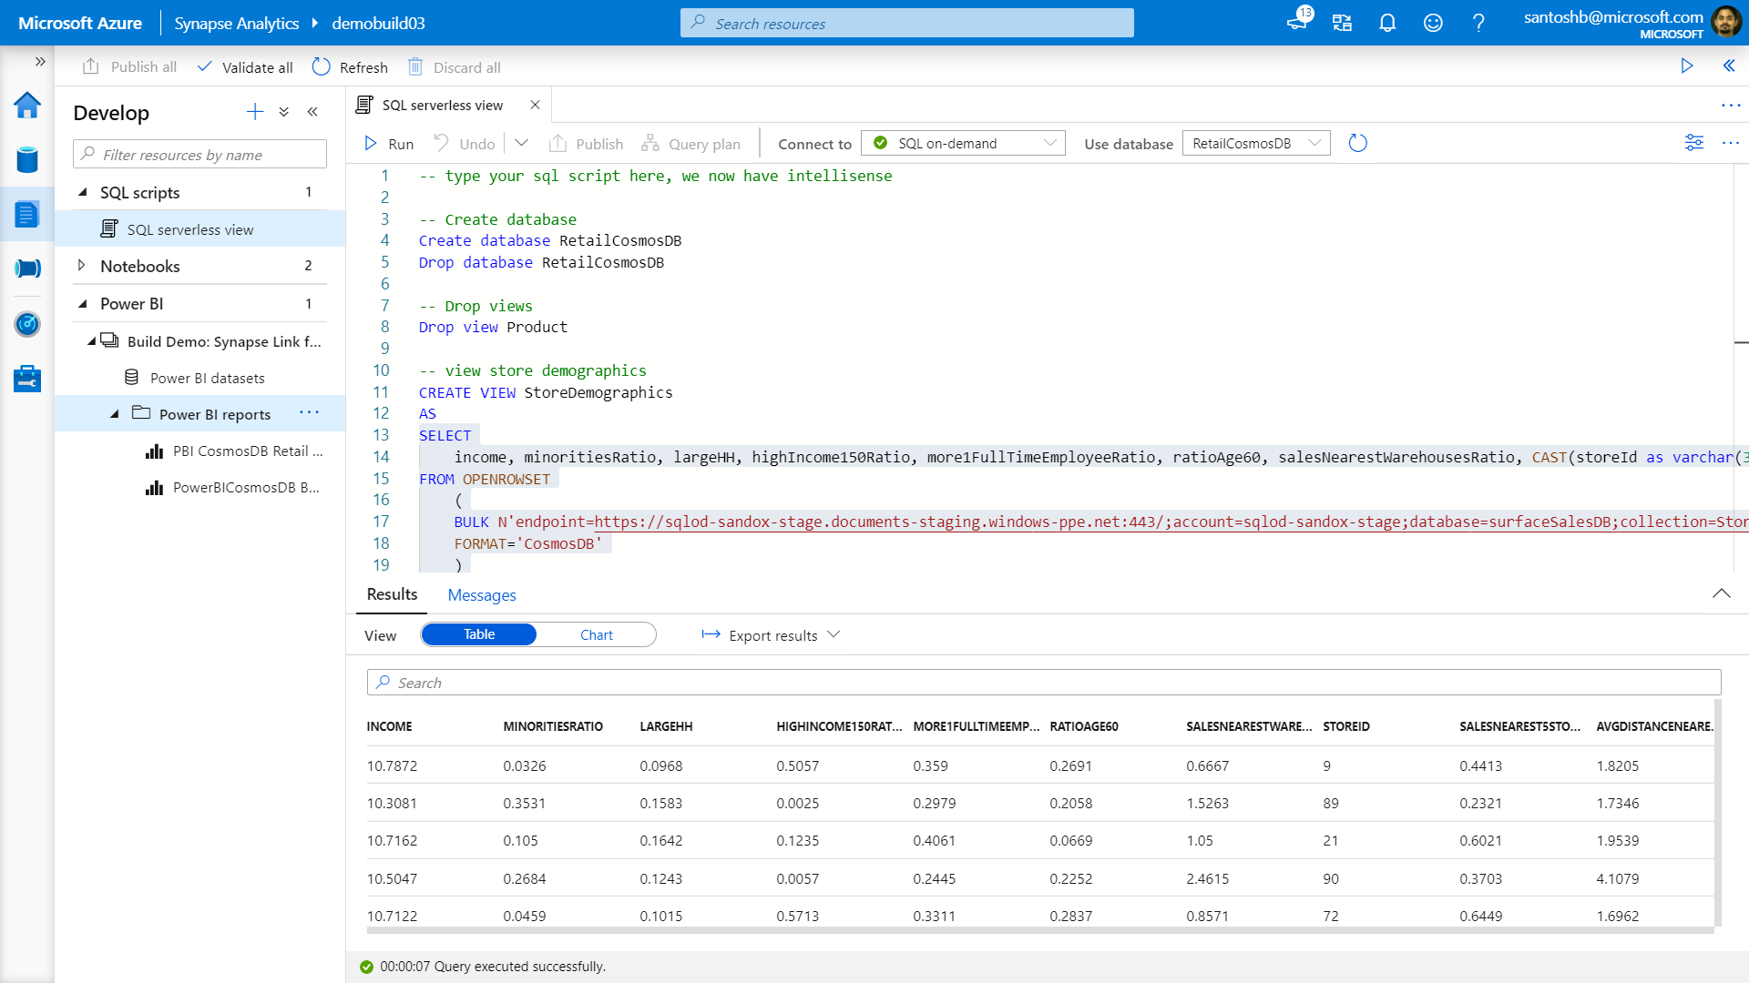

Slide 50
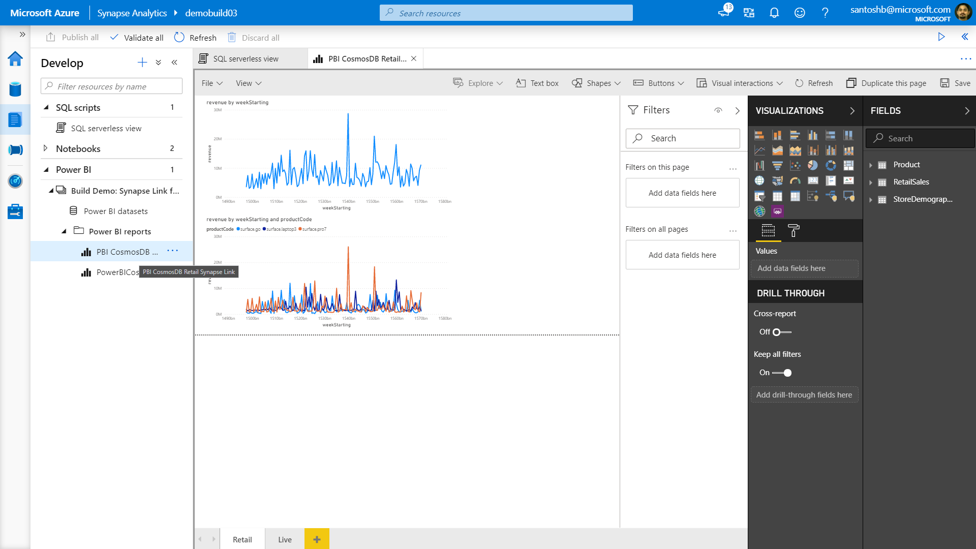

Slide 51
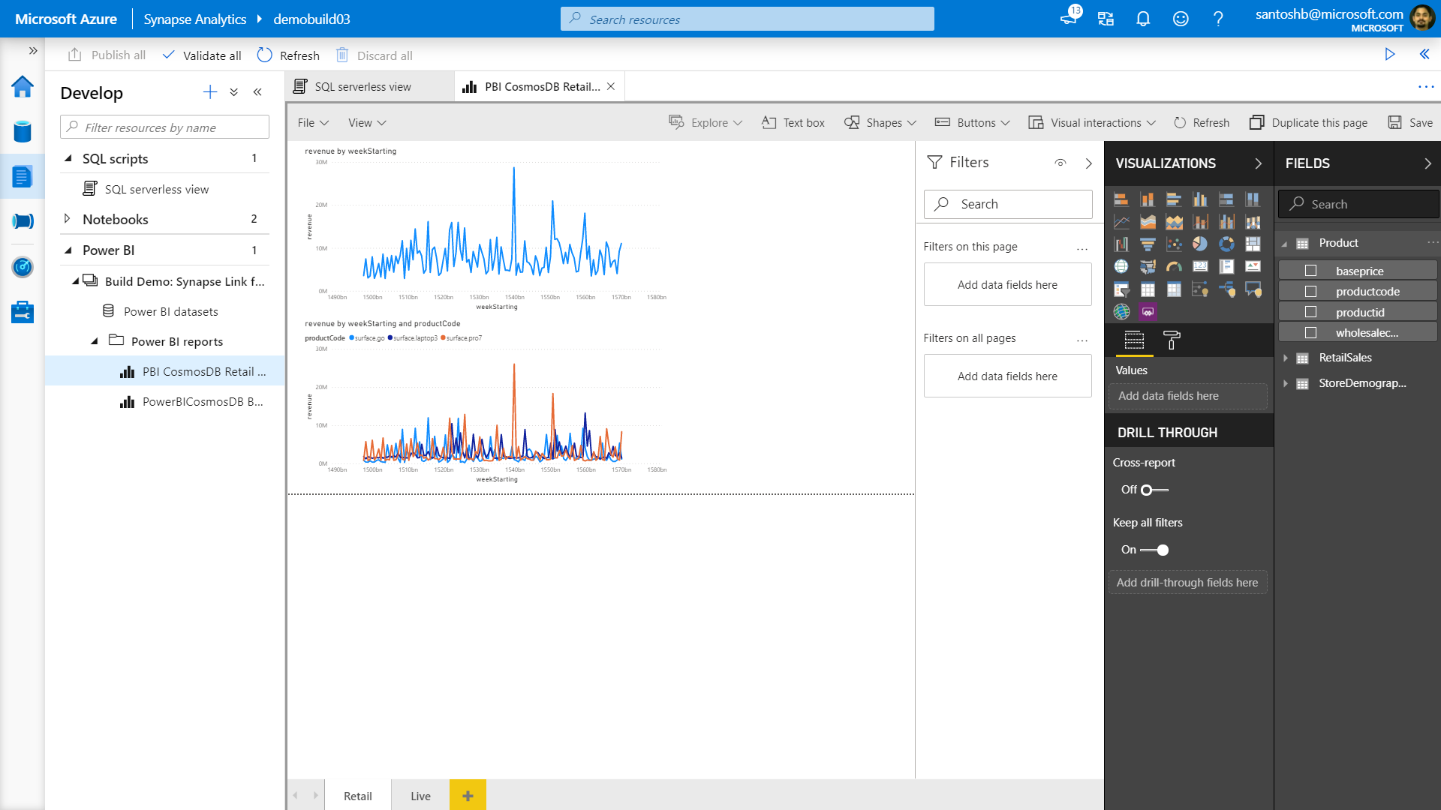

Slide 52
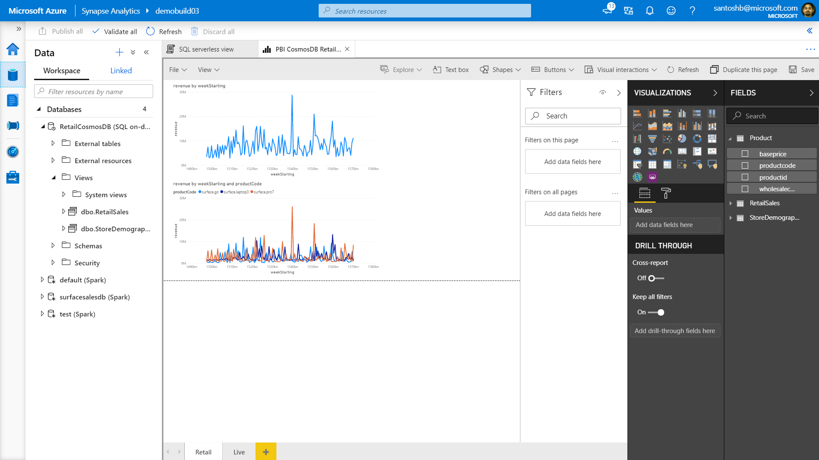

Slide 53
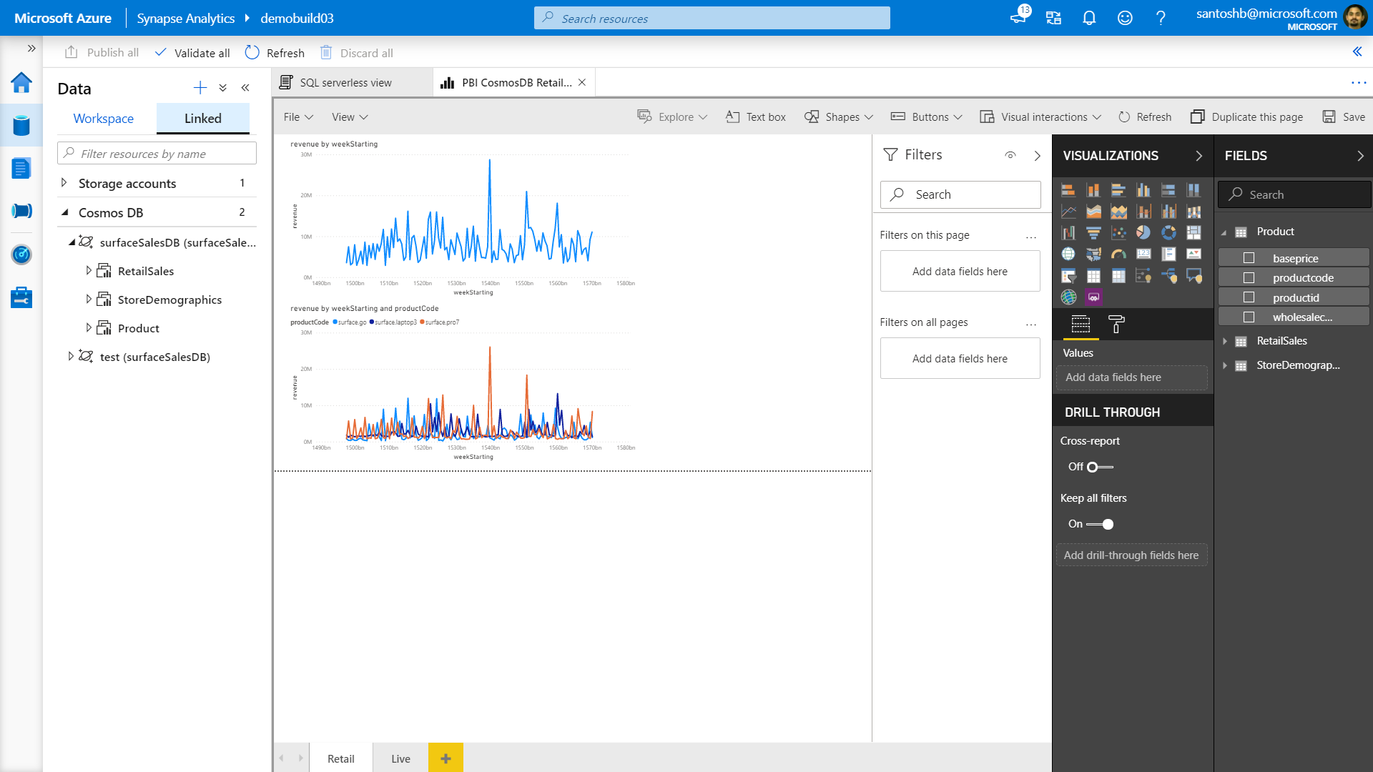

Slide 54


Slide 55
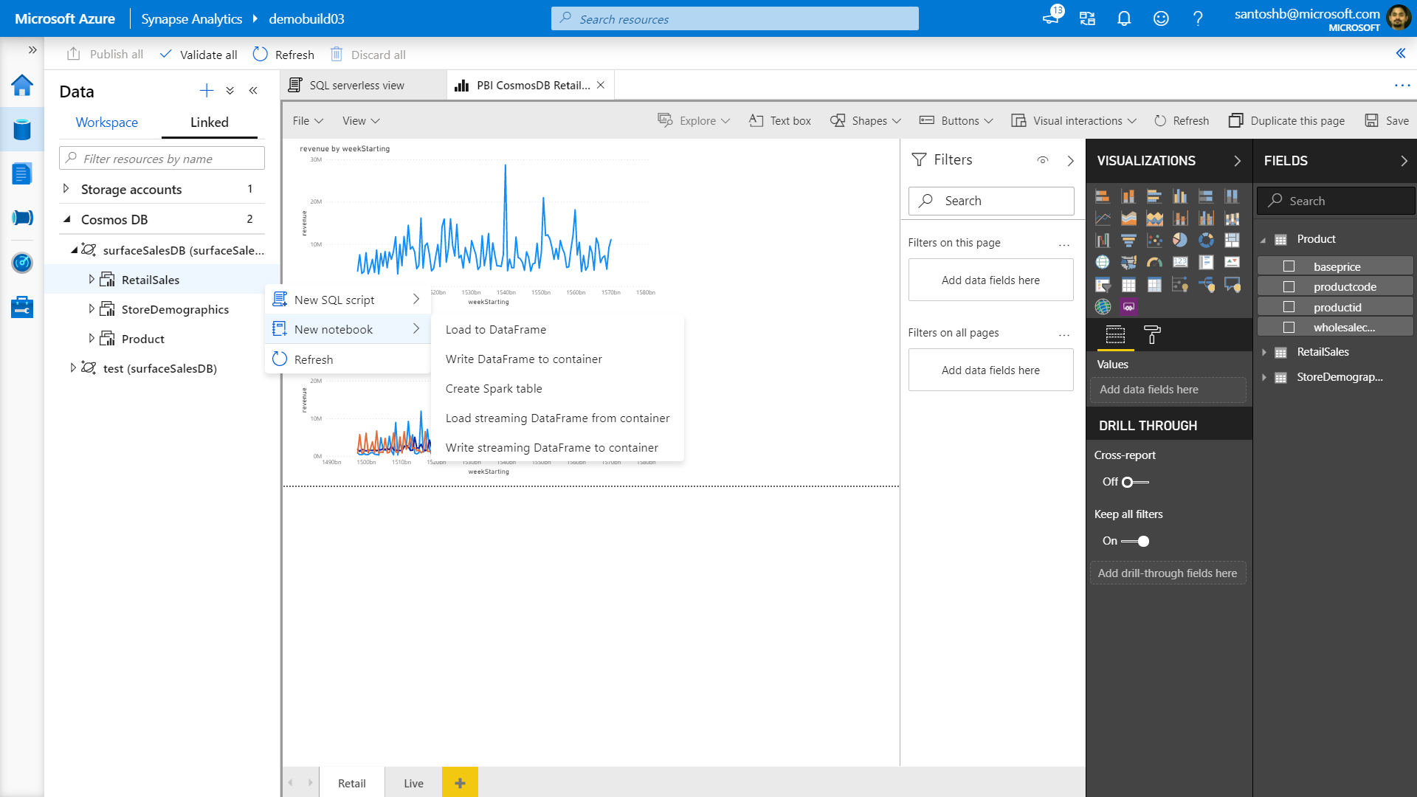

Slide 56
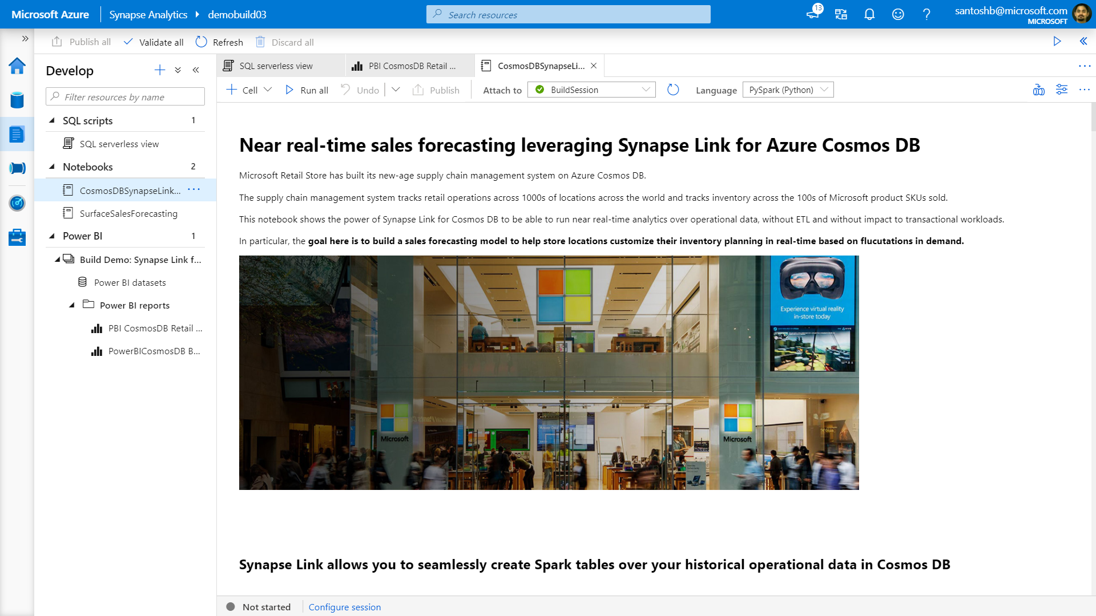

Slide 57
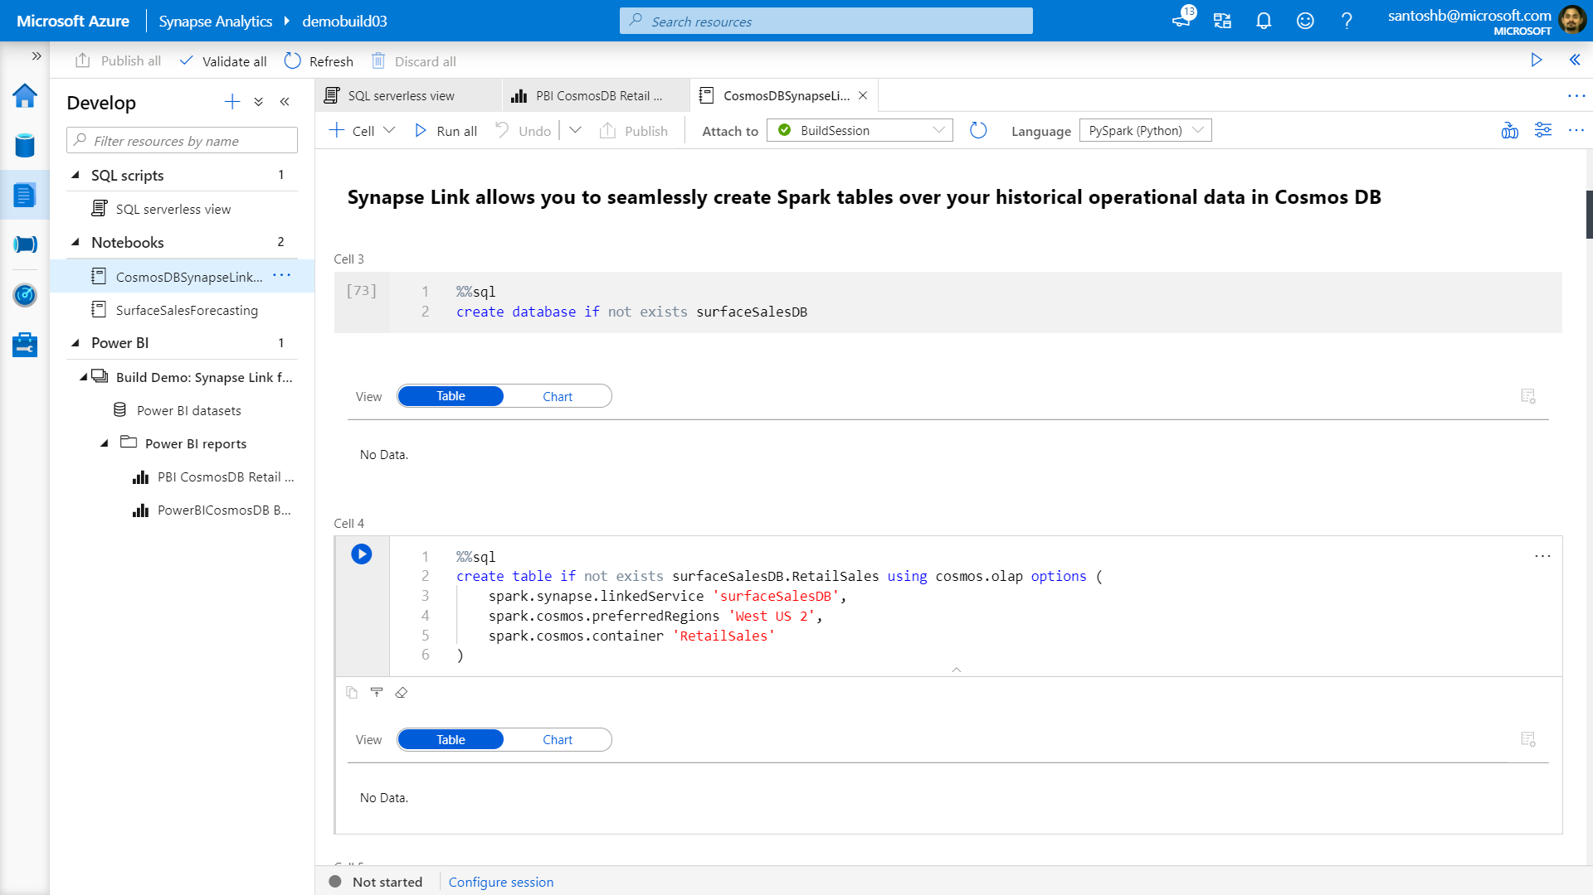

Slide 58
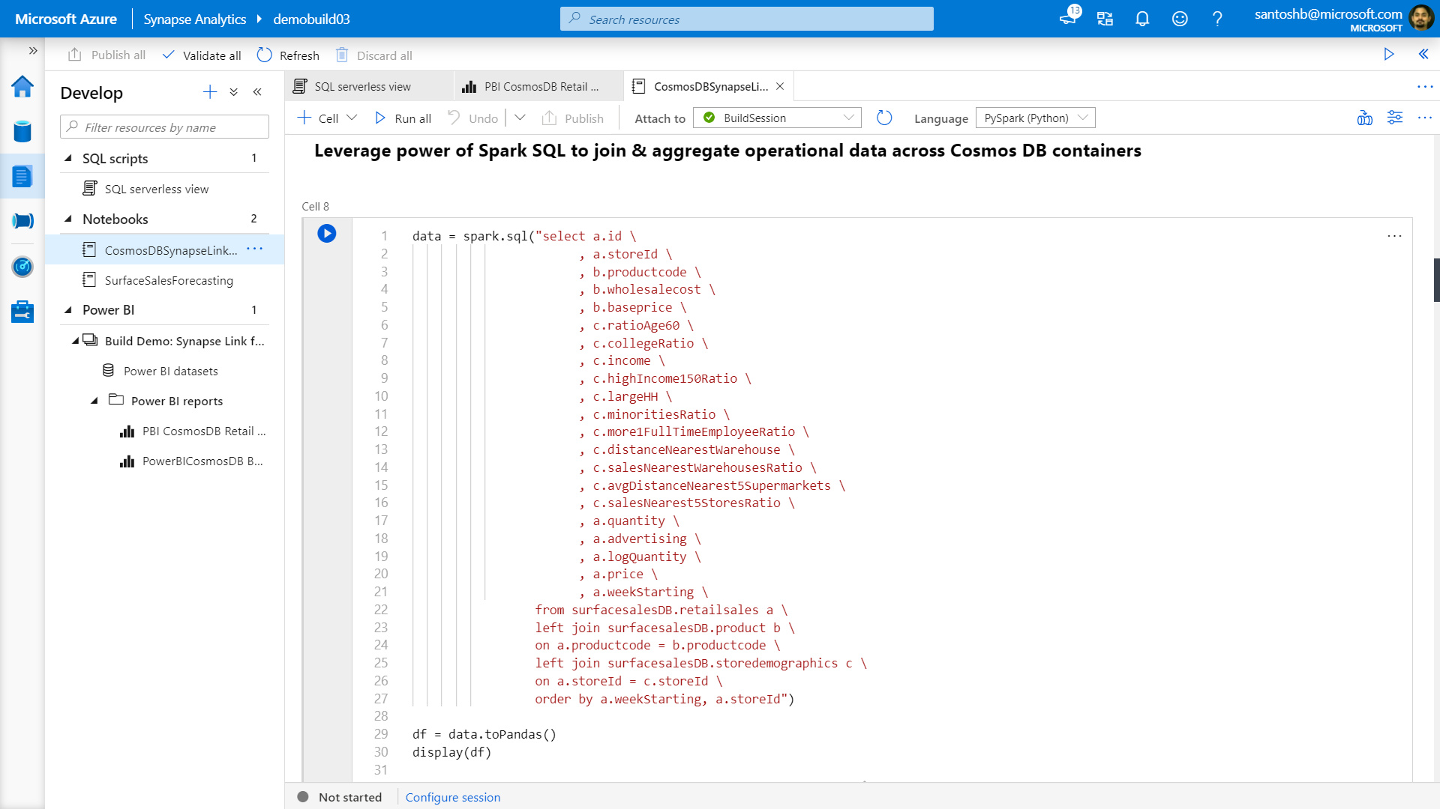

Slide 59
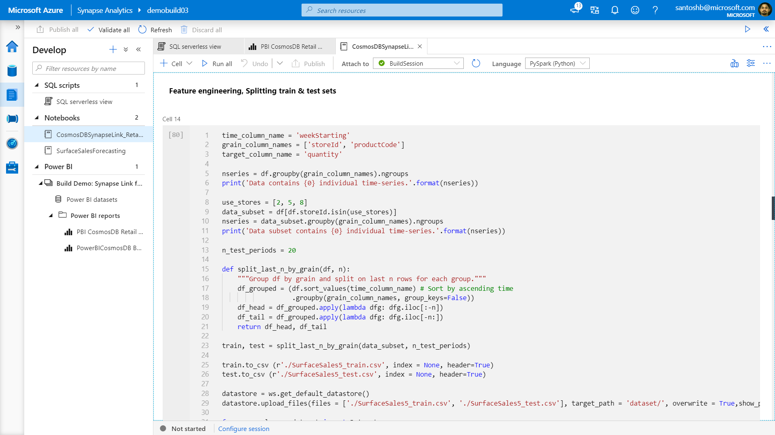

Slide 60
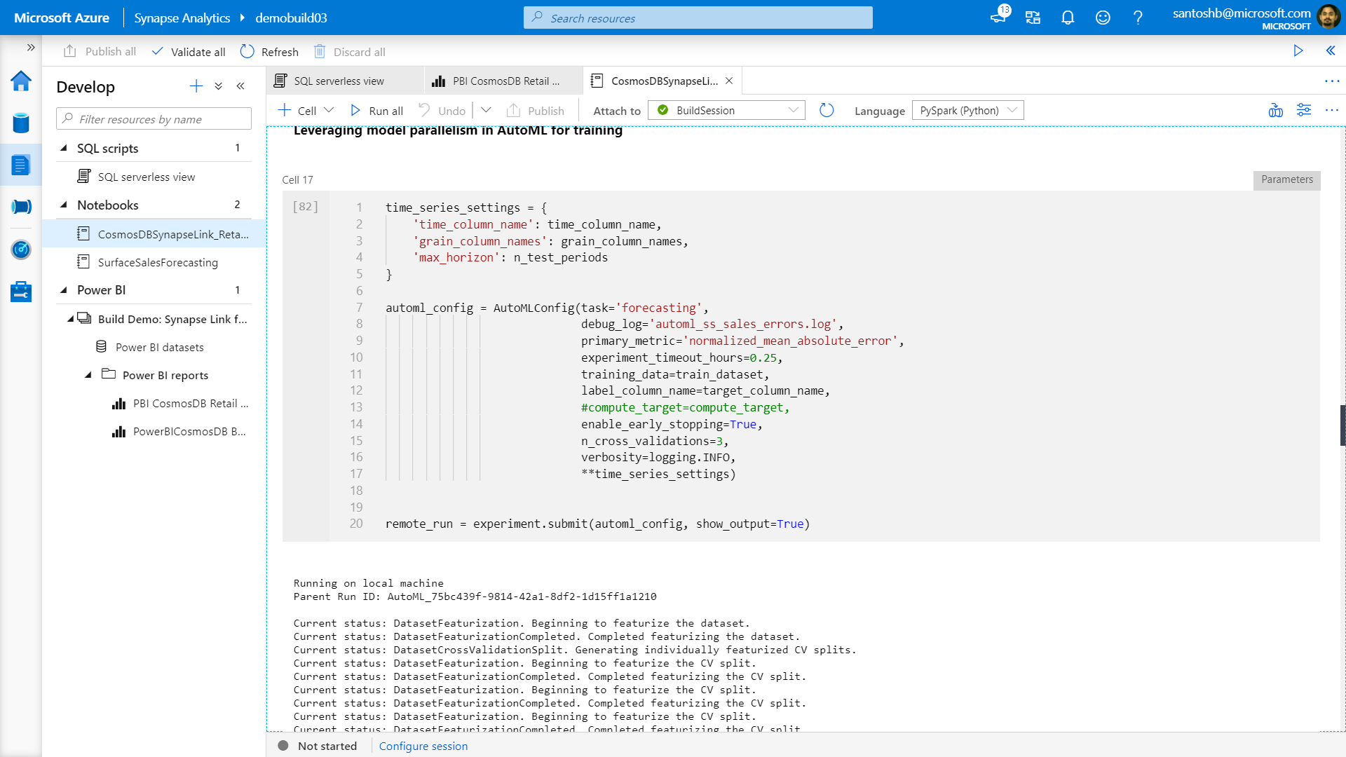

Slide 61
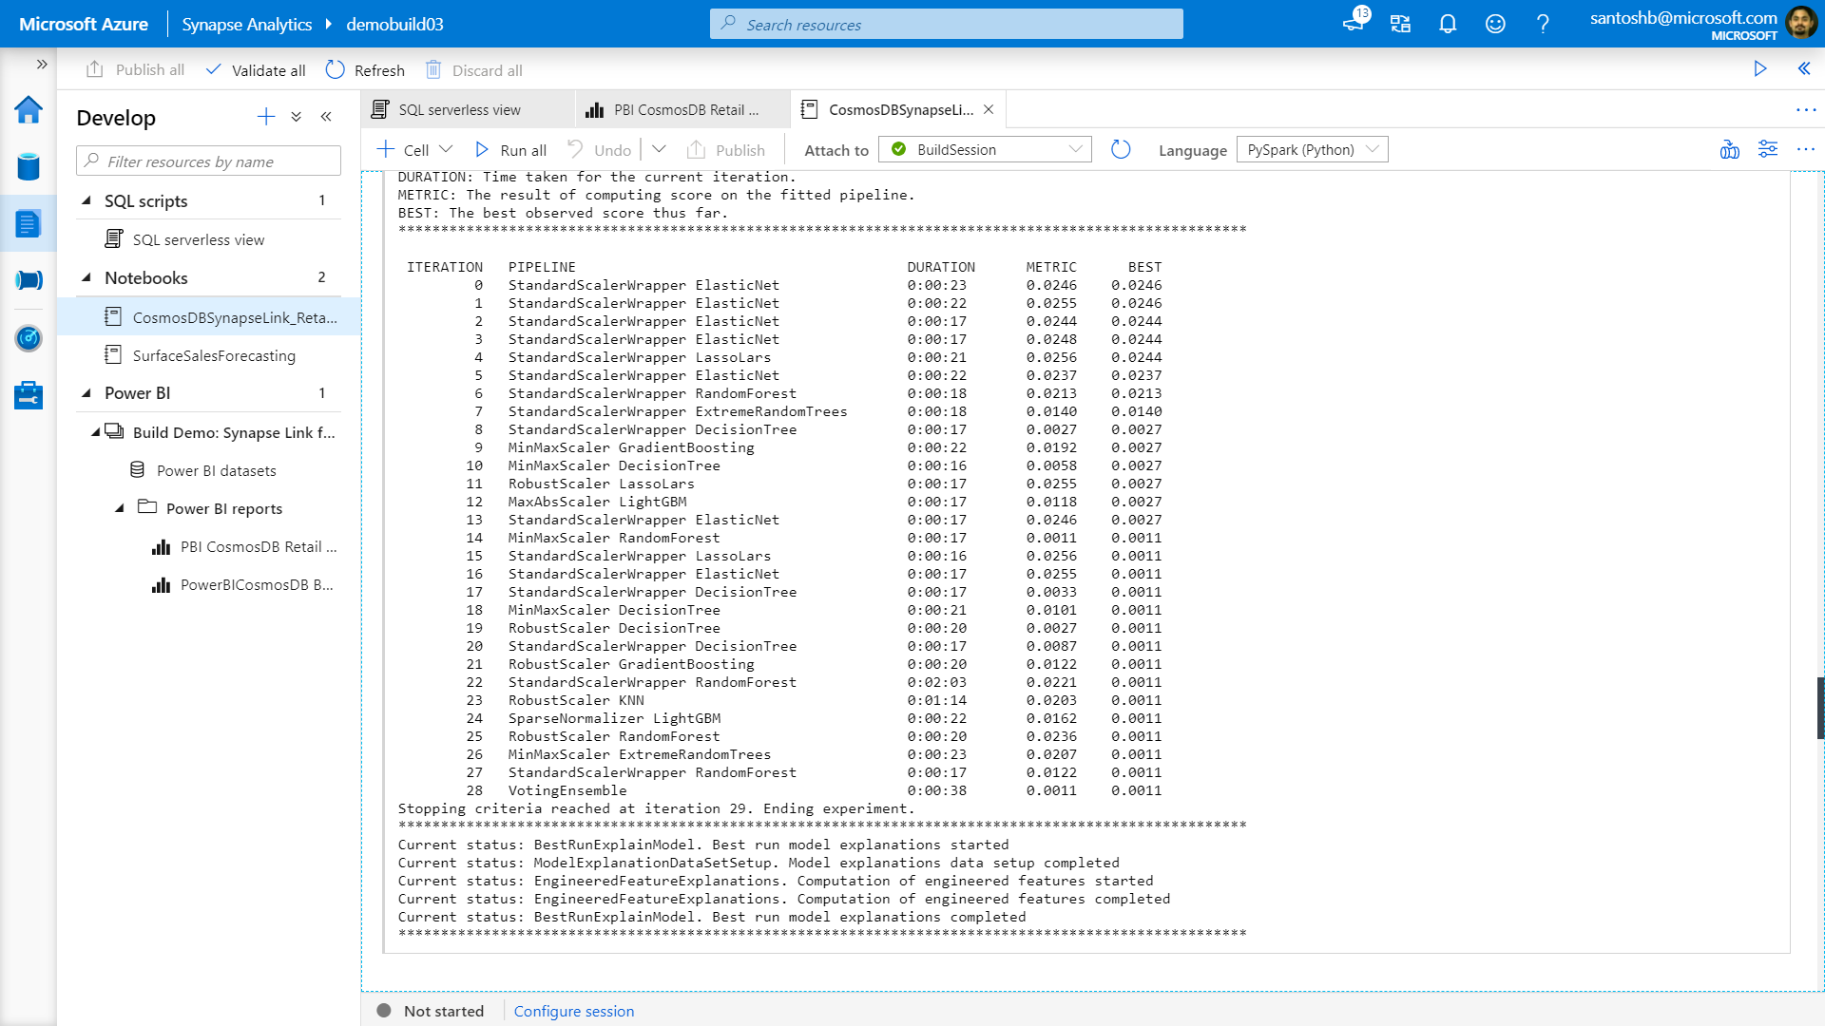

Slide 62
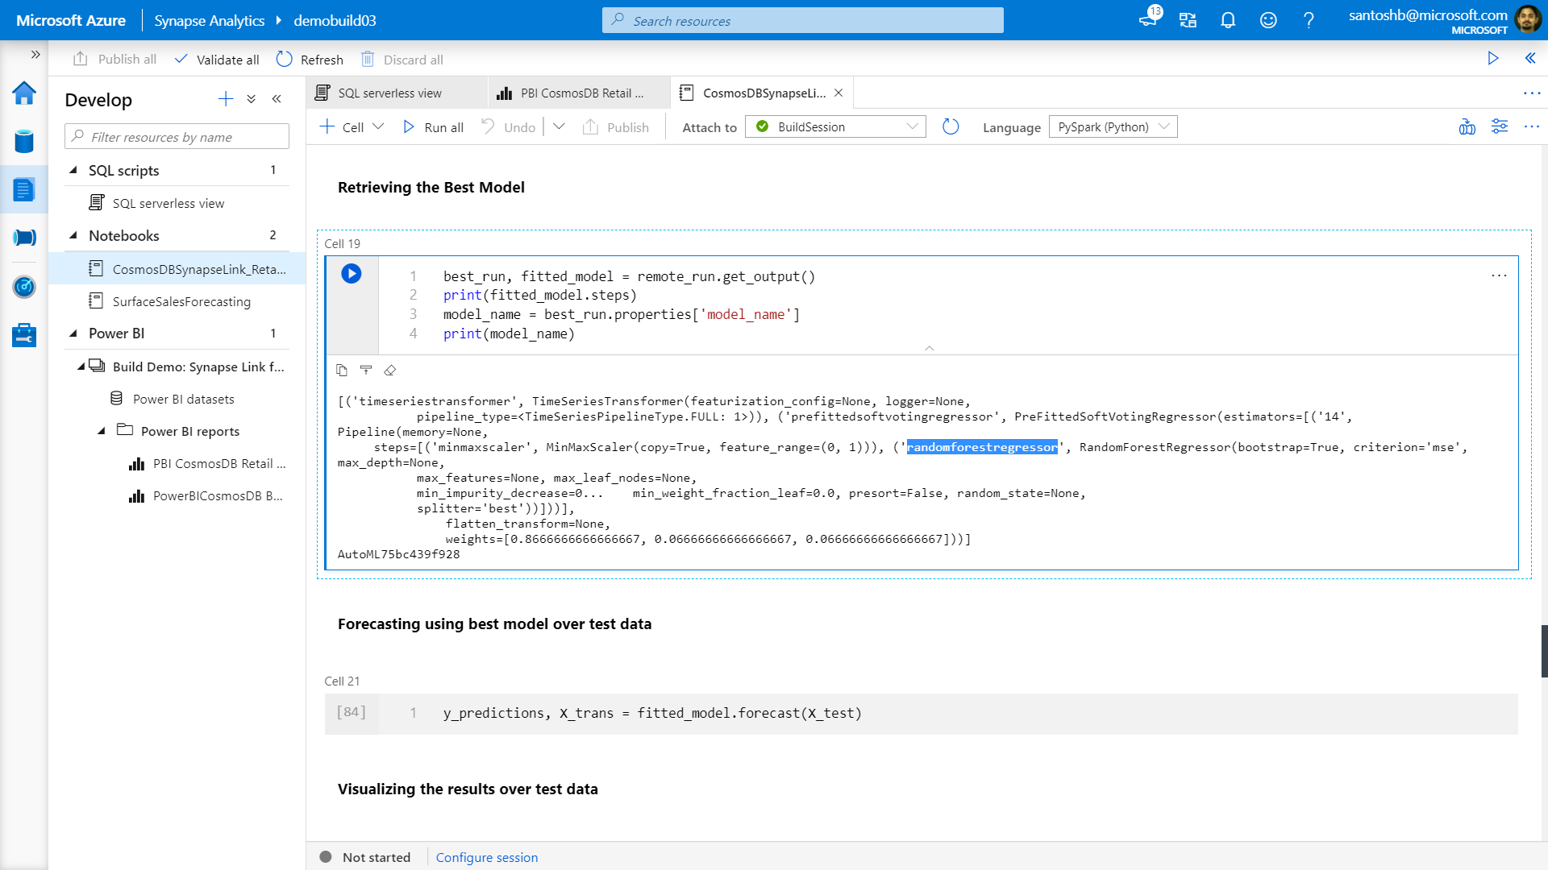

Slide 63


Slide 64


Slide 65



Azure Synapse Link Common Use Cases
Supply chain analytics, forecasting & reporting
Real-time personalization
IoT predictive maintenance

